Slide 1
Accelerated Chemical Kinetics for GEOS-Chem with Kppa
John C. Linford
jlinford@paratools.com
ParaTools, Inc.
IGC7, Harvard SEAS, Cambridge, MA
4 May 2015

Slide 2
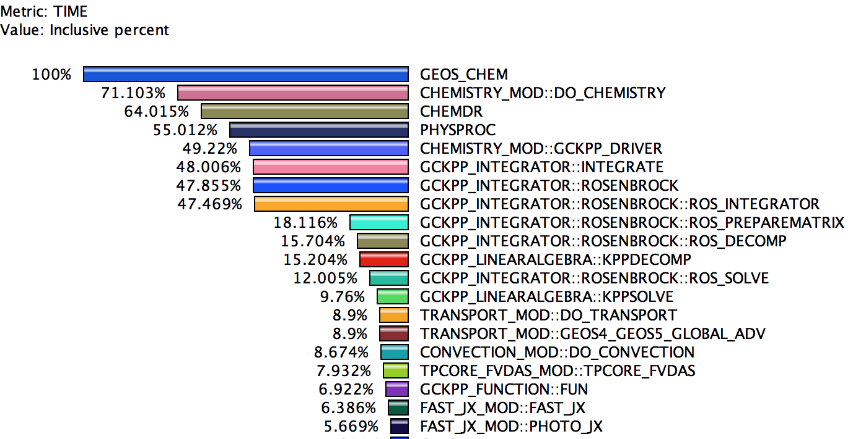
70% of GEOS-Chem Runtime is Chemistry
Eight threads
Intel Core i7-4820K CPU 3.70GHz

Slide 3
70% of GEOS-Chem Runtime is Chemistry
Eight threads
Intel Core i7-4820K CPU 3.70GHz

Slide 4
Kppa: The Kinetic PreProcessor Accelerated
CUDA
C
Architecture
Domain Specific Language
Fortran
Python
Serial
Multi-core
Code
optimized
Kppa
GPGPU
Intel MIC
Lexical parser
Analysis
Code generation

Slide 5
Sparse Matrix/Vector Code Generation
<%
d_Decomp.begin()
piv = lang.Variable('piv', REAL,
'Row element divided by diagonal')
piv.declare()
%>
${size_t} idx = blockDim.x*blockIdx.x+threadIdx.x;
if(idx < ${ncells32}) {
${A} += idx;
<%
lang.upindent()
for i in xrange(1, nvar):
for j in xrange(crow[i], diag[i]):
c = icol[j]
d = diag[c]
piv.assign(A[j*ncells32] / A[d*ncells32])
A[j*ncells32].assign(piv)
...
%>
}
<% d_Decomp.end() %>
Generates C, C++, CUDA, Fortran, or Python
A[334] = t1;
A[337] = -A[272]*t1 + A[337];
A[338] = -A[273]*t1 + A[338];
A[339] = -A[274]*t1 + A[339];
A[340] = -A[275]*t1 + A[340];
t2 = A[335]/A[329];
A[335] = t2;
A[337] = -A[330]*t2 + A[337];
A[338] = -A[331]*t2 + A[338];
A[339] = -A[332]*t2 + A[339];
A[340] = -A[333]*t2 + A[340];
t3 = A[341]/A[59];

Slide 6
Simplify Before Generating Code
X[27] = ((A[43]*A[43]*A[43]) + (A[43]*A[43]) – (A[43]) – (5+4)) / (A[43]*A[43] + (8-6)*A[43] + 1)
Simplify
Fortran
X(28) = A(44) - 1

Slide 7
Performance Results
Baseline: hand-tuned KPP-generated code
Use KPP to generate a serial code
A skilled programmer parallelizes the code
Comparison: unmodified Kppa-generated code
Same input file format as KPP
Little or no modification to source
Results:
Xeon Phi: 140% faster
NVIDIA K40: 160% faster
Xeon with OpenMP: 60% faster
Exact same hardware

Slide 8
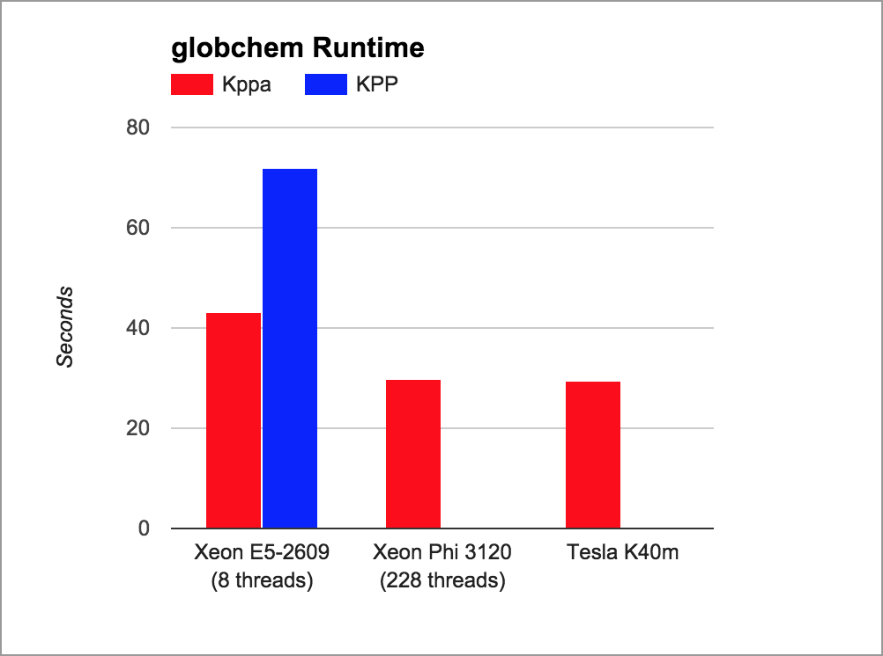
Performance Results

Slide 9
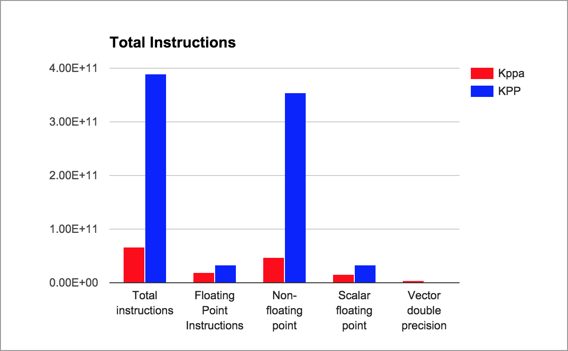
Fewer Operations, Faster Runtimes
TAU configured with PAPI and PDT

Slide 10
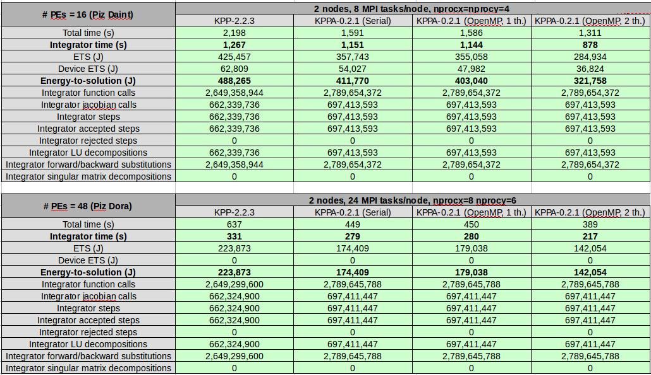
COSMO-ART Benchmarks
Will Sawyer, Charles Joseph (CSCS)

Slide 11
Next Steps
Partnership with David Topping (Manchester)
EMiT 2015 Keynote
Horizon 2020 proposal
Aerosols
MCM
Large mechanisms
Partnership with Will Sawyer (CSCS)
PRACE integrator
About 4x faster in COSMO-ART

Slide 12
http://www.paratools.com/kppa
Downloads, tutorials, resources

