Slide 1
Python Performance Evaluation with the
TAU Performance System
John C. Linford, Sameer Shende, Allen Malony
{jlinford,sameer,malony}@paratools.com
ParaTools, Inc.
2 July 2015, EMiT’15
www.paratools.com/emit15/TAU

Slide 2
Tutorial Overview
Performance optimization of Python applications
We will cover:
  Profiling and debugging via the TAU Performance System
  Performance analysis of Python, C/C++, Fortran
  Python+X analysis
  MPI and/or OpenMP analysis
  Memory debugging
  Hardware performance counters (PAPI)

Slide 3
Schedule
The TAU Performance System from 10,000 feet
Live demonstration of TAU + Python
Hands-on TAU with:
  Simple pure Python
  Python + X
  Let’s build a CTM…
    With Ipython!

Slide 4
The TAU Performance System
Python Performance Evaluation

Slide 5
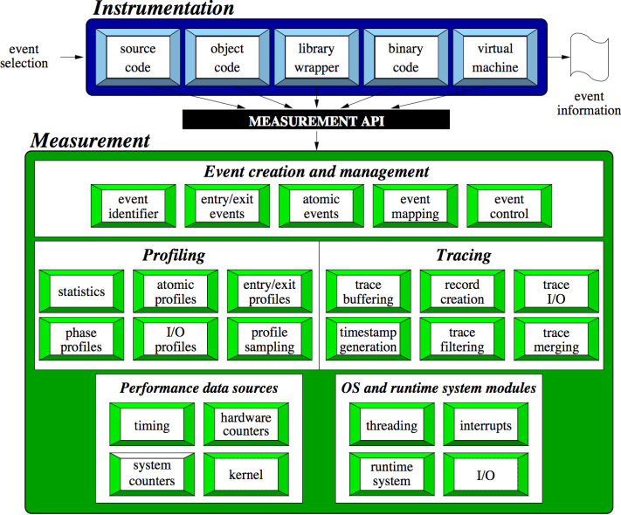
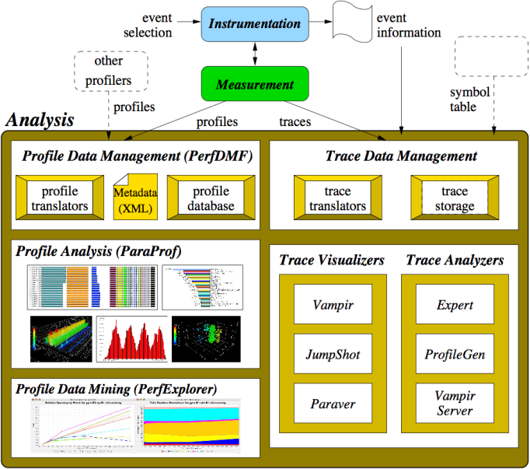
The TAU Performance System®
TAU Architecture
Integrated toolkit for performance problem solving
  Instrumentation, measurement, analysis, visualization
  Portable profiling and tracing
  Performance data management and data mining
Direct and indirect measurement
Free, open source, BSD license
Available on all HPC platforms (and many non-HPC)
http://tau.uoregon.edu/

Slide 6

The TAU Performance System®
Tuning and Analysis Utilities (20+ year project)
Comprehensive performance profiling and tracing
  Integrated, scalable, flexible, portable
  Targets all parallel programming/execution paradigms
Integrated performance toolkit
  Instrumentation, measurement, analysis, visualization
  Widely-ported performance profiling / tracing system
  Performance data management and data mining
  Open source (BSD-style license)
Integrates with application frameworks

Slide 7
Questions TAU Can Answer
How much time is spent in each application routine and outer loops? Within loops, what is the contribution of each statement?
How many instructions are executed in these code regions?
Floating point, Level 1 and 2 data cache misses, hits, branches taken, vector instructions?
What is the memory usage of the code? When and where is memory allocated/de-allocated? Are there any memory leaks?
What are the I/O characteristics of the code? What is the peak read and write bandwidth of individual calls, total volume?
What is the time spent waiting for collectives?
How does the application scale?

Slide 8
TAU Supports All HPC Platforms
C/C++
CUDA
UPC
Python
GPI
Fortran
OpenACC
MPI
Java
pthreads
Intel MIC
OpenMP
Intel
GNU
PGI
Sun
LLVM
Cray
MinGW
AIX
Linux
Windows
Insert yours
here
BlueGene
Fujitsu
ARM
Android
MPC
OS X

Slide 9
Vocabulary
Python Performance Evaluation

Slide 10
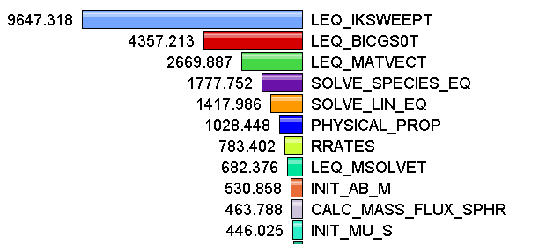
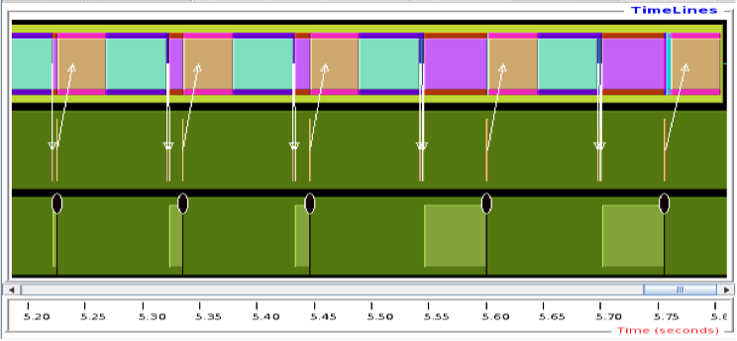
Measurement Approaches
Profiling
Tracing
Shows
how much time was spent in each routine
Shows
when events take place on a timeline

Slide 11
Types of Performance Profiles
Flat profiles
  Metric (e.g., time) spent in an event
  Exclusive/inclusive, # of calls, child calls, …
Callpath profiles
  Time spent along a calling path (edges in callgraph)
  “main=> f1 => f2 => MPI_Send”
  Set the TAU_CALLPATH_DEPTH environment variable
Phase profiles
  Flat profiles under a phase (nested phases allowed)
  Default “main” phase
  Supports static or dynamic (e.g. per-iteration) phases
Notes:
Collect basic routine-level timing profile to determine where most time is being spent
Collect routine-level hardware counter data to determine types of performance problems
Collect callpath profiles to determine sequence of events causing performance problems
Conduct finer-grained profiling and/or tracing to pinpoint performance bottlenecks
Loop-level profiling with hardware counters
Tracing of communication operations

Slide 12
How much data do you want?
Limited
Profile
Loop
Profile
Callpath
Profile
O(KB)
O(TB)
Flat
Profile
Phase
Profile
Trace
All levels support multiple metrics/counters

Slide 13
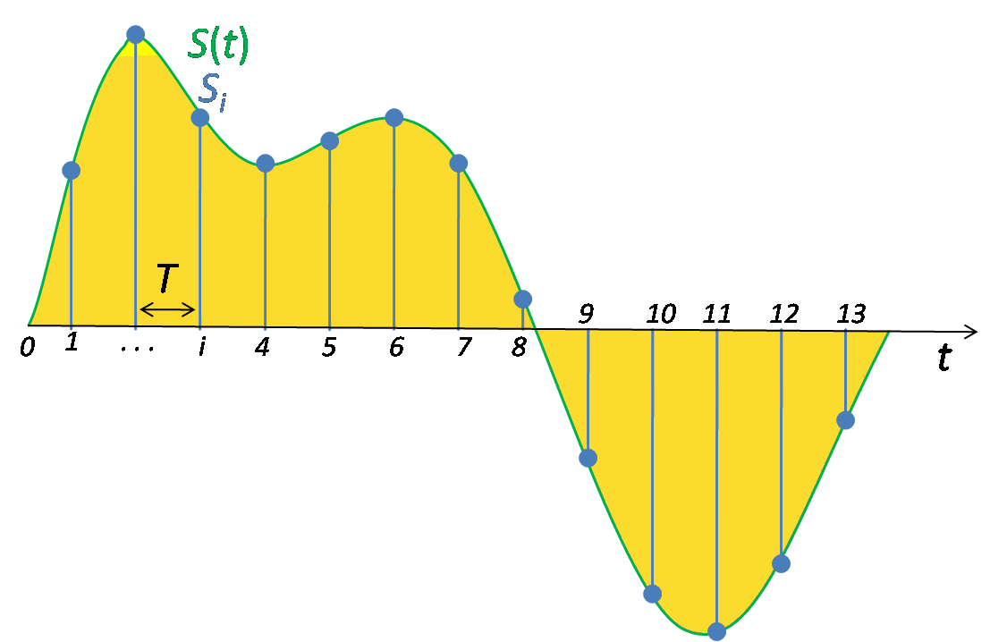
Performance Data Measurement
Direct via Probes
Indirect via Sampling
call TAU_START(‘potential’)
// code
call TAU_STOP(‘potential’)
Exact measurement
Fine-grain control
Calls inserted into code
No code modification
Minimal effort
Relies on debug symbols (-g option)

Slide 14
Inclusive vs. Exclusive Measurements
Exclusive measurements for region only
Inclusive measurements includes child regions
int foo()
{
int a;
a =a + 1;
bar();
a =a + 1;
return a;
}
inclusive
duration
exclusive
duration

Slide 15
Performance analysis workflow
Python Performance Evaluation

Slide 16
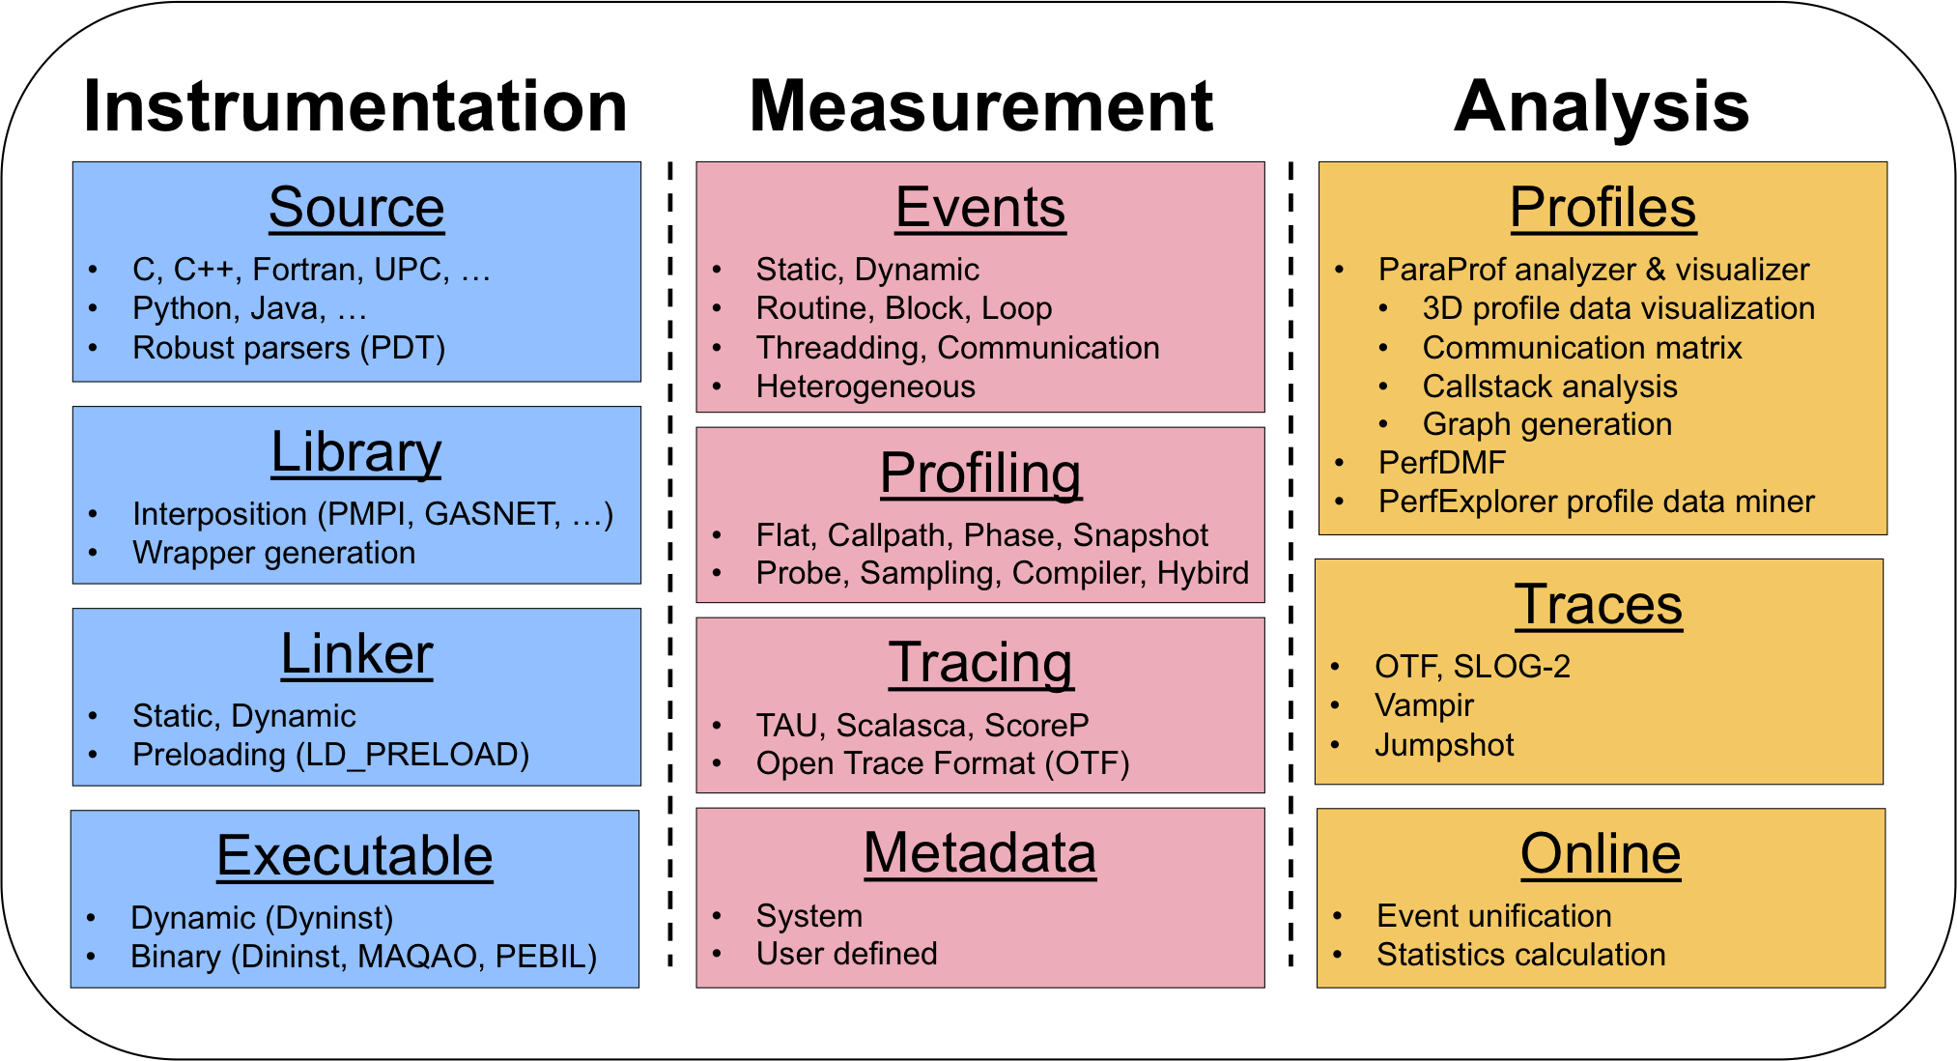
TAU Architecture and Workflow

Slide 17
Instrument: Add Probes
  Source code instrumentation
    PDT parsers, pre-processors
  Wrap external libraries
    I/O, MPI, Memory, CUDA, OpenCL, pthread
  Rewrite the binary executable
    Dyninst, MAQAO

Slide 18
Insert TAU API Calls Automatically
Use TAU’s compiler wrappers
  Replace C++ compiler with tau_cxx.sh, etc.
  Automatically instruments source code, links with TAU libraries.
Use tau_cc.sh for C, tau_f90.sh for Fortran, etc.
Makefile without TAU
Makefile with TAU
CXX = mpicxx
F90 = mpif90
CXXFLAGS =
LIBS = -lm
OBJS = f1.o f2.o f3.o … fn.o
app: $(OBJS)
$(CXX) $(LDFLAGS) $(OBJS) -o $@
$(LIBS)
.cpp.o:
$(CXX) $(CXXFLAGS) -c $<
CXX = tau_cxx.sh
F90 = tau_f90.sh
CXXFLAGS =
LIBS = -lm
OBJS = f1.o f2.o f3.o … fn.o
app: $(OBJS)
$(CXX) $(LDFLAGS) $(OBJS) -o $@ $(LIBS)
.cpp.o:
$(CXX) $(CXXFLAGS) -c $<

Slide 19
Measure: Gather Data
  Direct measurement via probes
  Indirect measurement via sampling
  Throttling and runtime control
  Interface with external packages (PAPI)

Slide 20
Direct Observation Events
Interval events (begin/end events)
  Measures exclusive & inclusive durations between events
  Metrics monotonically increase
  Example: Wall-clock timer
Atomic events (trigger with data value)
  Used to capture performance data state
  Shows extent of variation of triggered values (min/max/mean)
  Example: heap memory consumed at a particular point
Code events
  Routines, classes, templates
  Statement-level blocks, loops
  Example: for-loop begin/end

Slide 21
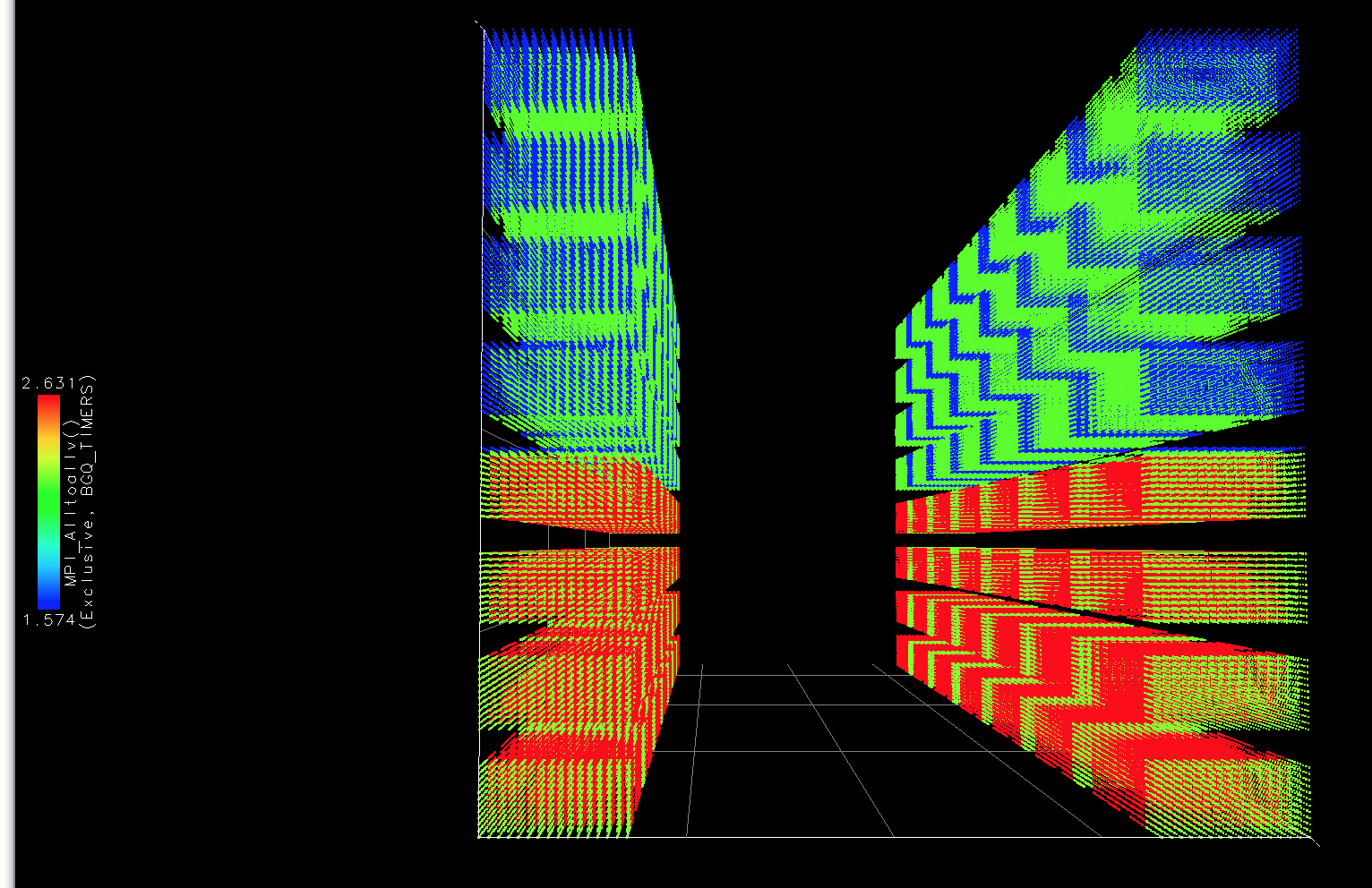
Analyze: Synthesize Knowledge
  Data visualization
  Data mining
  Statistical analysis
  Import/export performance data

Slide 22


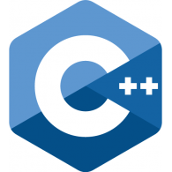
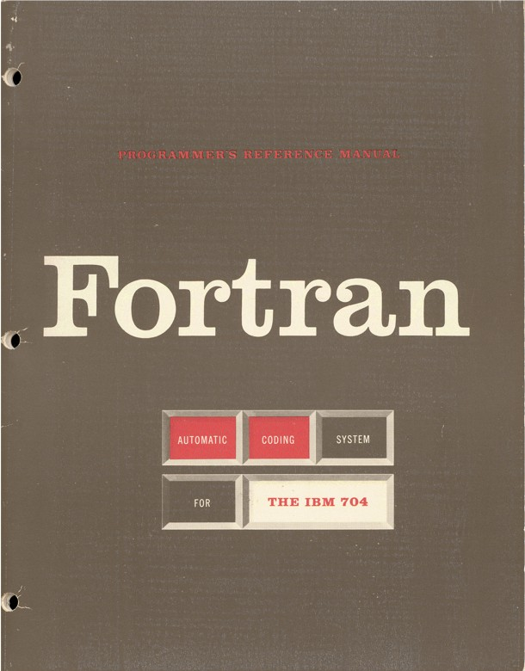
Multi-Language Debugging
Identify the source location of a crash by unwinding the system callstack
Identify memory errors (off-by-one, etc.) across language boundaries
double * x =
new double[5];
A = x[1:10] + 5

Slide 23
Memory debugging
TAU with
various options
Note: Requires working mprotect() so BGQ not supported

Slide 24
Analysis examples
Python Performance Evaluation

Slide 25
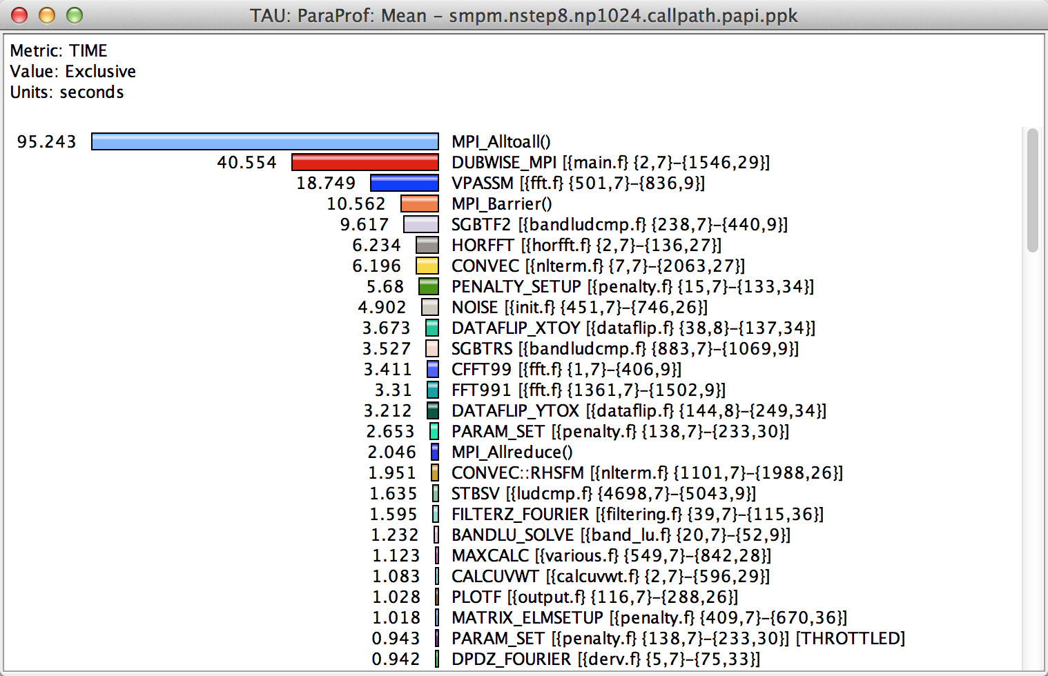
How Much Time per Code Region?
% paraprof (Click on label, e.g. “Mean” or “node 0”)
Notes:
How much time per code region?
How many instructions per code region?
What is the cost of each code statement?
L1 or L2 cache misses?

Slide 26
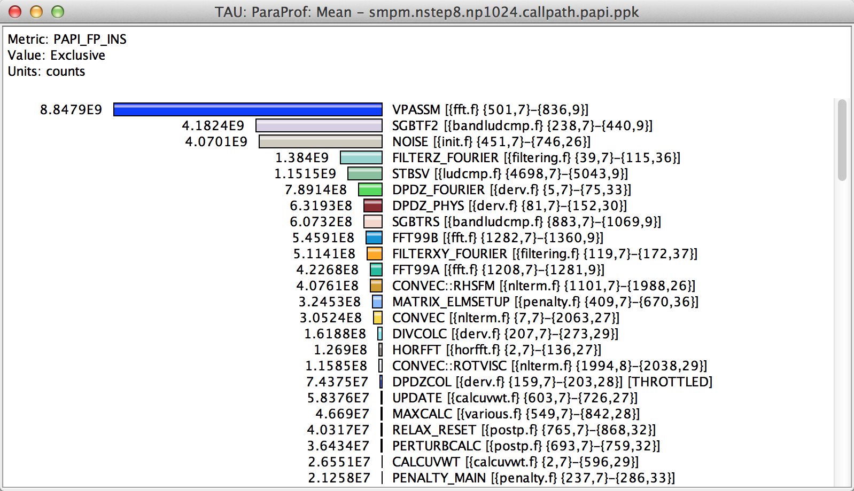
How Many Instructions per Code Region?
% paraprof (Options → Select Metric... → Exclusive… → PAPI_FP_INS)
Notes:
How much time per code region?
How many instructions per code region?
What is the cost of each code statement?
L1 or L2 cache misses?

Slide 27
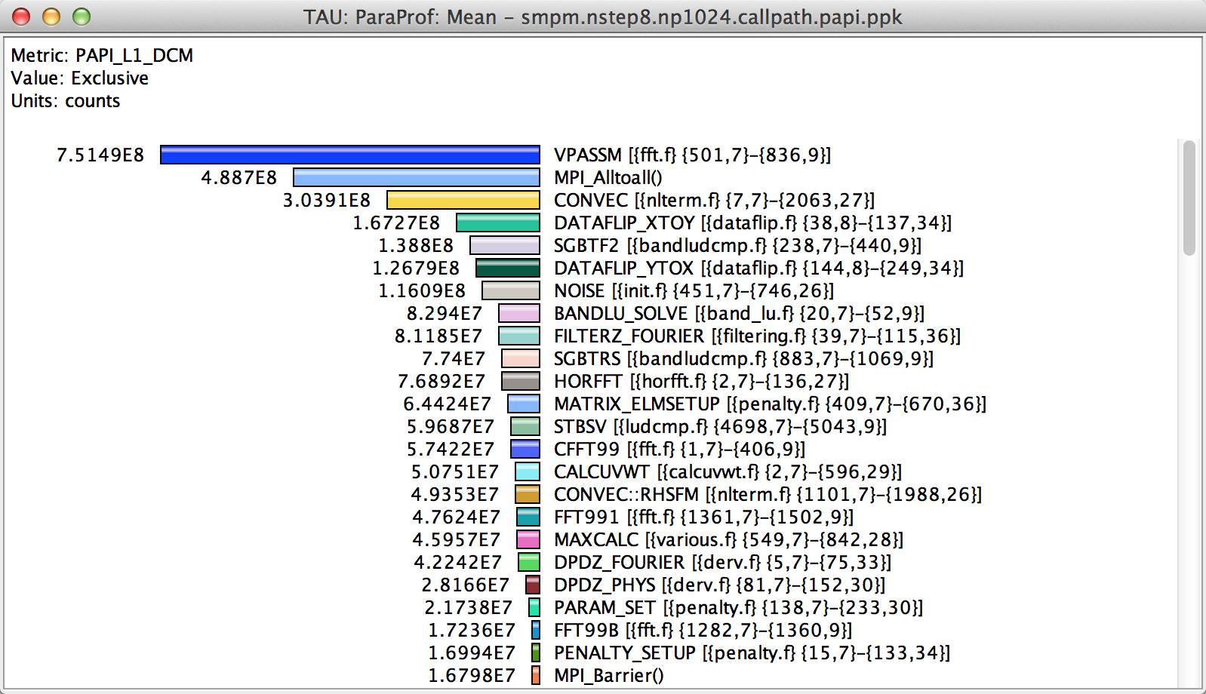
How Many L1 or L2 Cache Misses?
% paraprof (Options → Select Metric... → Exclusive… → PAPI_L1_DCM)
Notes:
How much time per code region?
How many instructions per code region?
What is the cost of each code statement?
L1 or L2 cache misses?

Slide 28
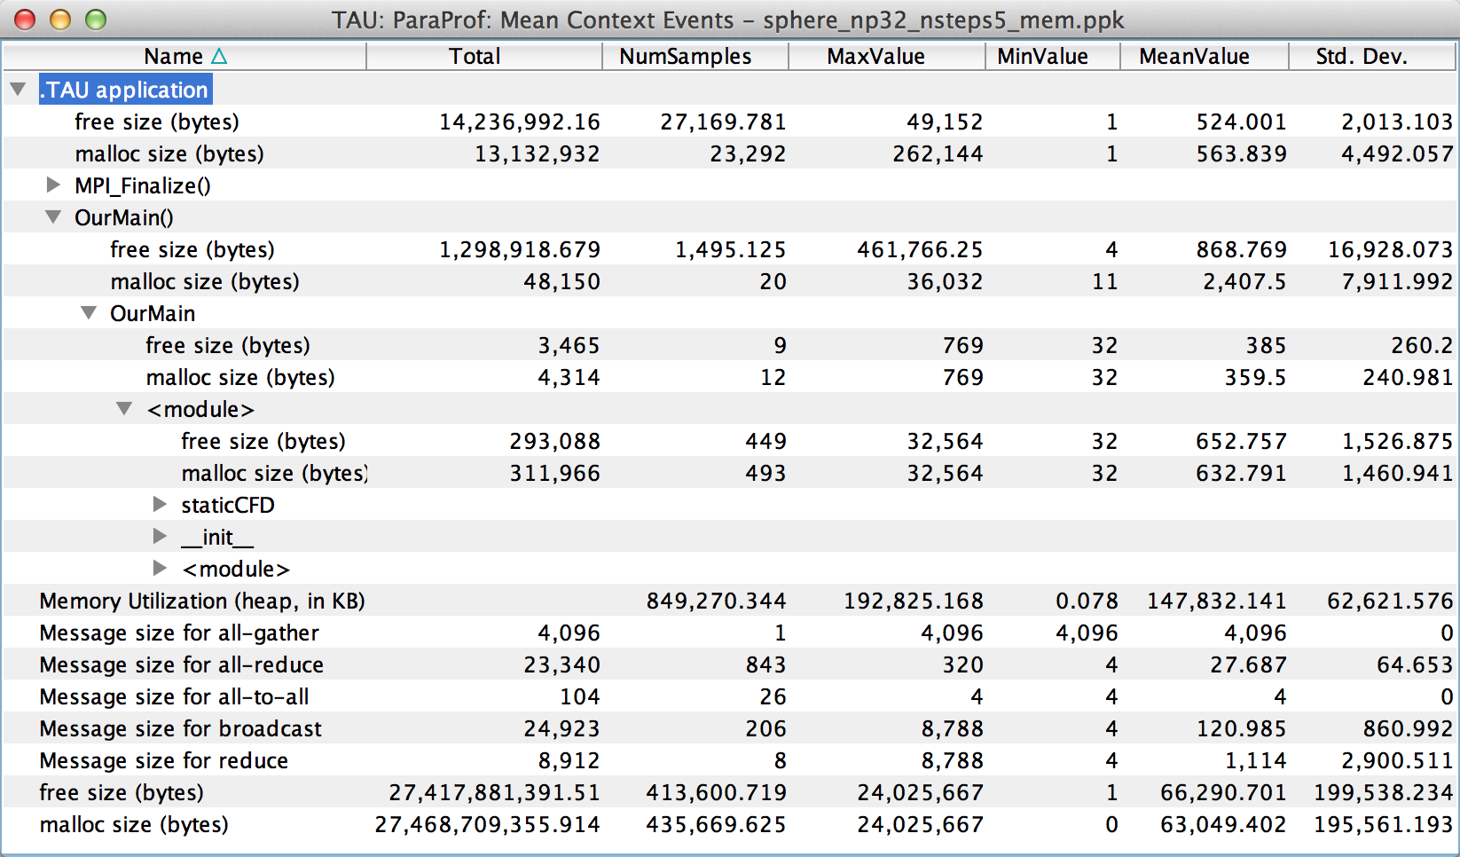
How Much Memory Does the Code Use?
High-water mark
% paraprof (Right-click label [e.g “node 0”] → Show Context Event Window)
Notes:
Heap memory usage reported by the mallinfo() call is not 64-bit clean.
32 bit counters in Linux roll over when > 4GB memory is used
We keep track of heap memory usage in 64 bit counters inside TAU
Compensation of perturbation introduced by tool
Only show what application uses
Create guards for TAU calls to not track I/O and memory allocations/de-allocations performed inside TAU
Provide broad POSIX I/O and memory coverage

Slide 29
How Much Memory Does the Code Use?
Total allocated/deallocated
% paraprof (Right-click label [e.g “node 0”] → Show Context Event Window)
Notes:
What is the memory usage of the code?
When/where is memory allocated?
Are there any memory leaks?
What are the I/O characteristics?

Slide 30
Where is Memory Allocated / Deallocated?
Allocation / Deallocation Events
% paraprof (Right-click label [e.g “node 0”] → Show Context Event Window)
Notes:
What is the memory usage of the code?
When/where is memory allocated?
Are there any memory leaks?
What are the I/O characteristics?

Slide 31
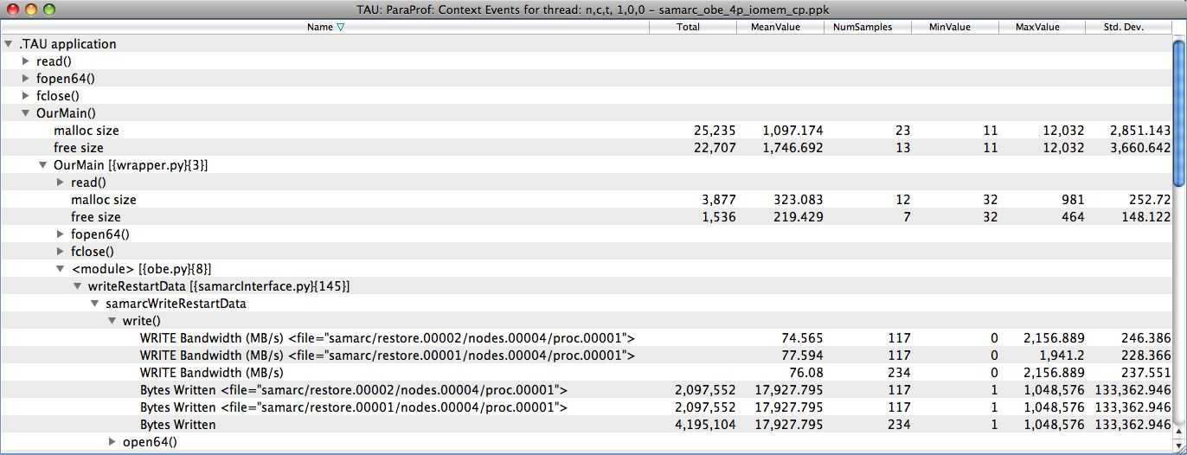
What are the I/O Characteristics?
Write bandwidth per file
Bytes written to each file
% paraprof (Right-click label [e.g “node 0”] → Show Context Event Window)
Notes:
What is the memory usage of the code?
When/where is memory allocated?
Are there any memory leaks?
What are the I/O characteristics?

Slide 32
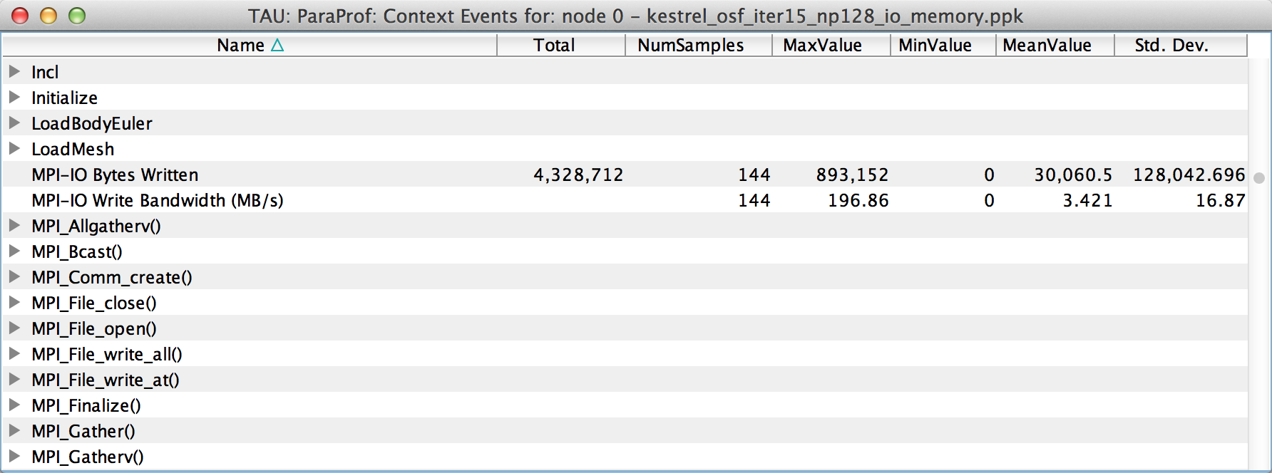
What are the I/O Characteristics?
Peak MPI-IO Write Bandwidth
% paraprof (Right-click label [e.g “node 0”] → Show Context Event Window)
Notes:
What is the memory usage of the code?
When/where is memory allocated?
Are there any memory leaks?
What are the I/O characteristics?

Slide 33
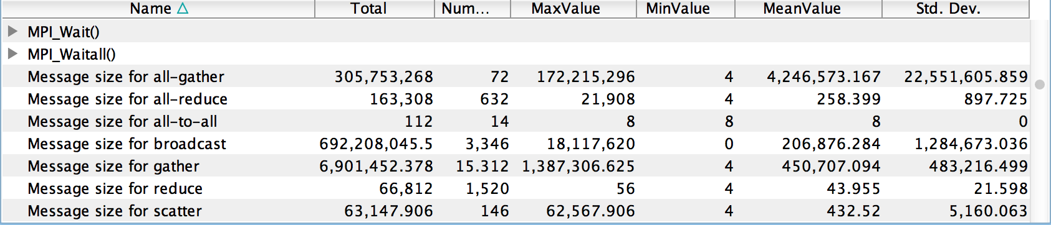
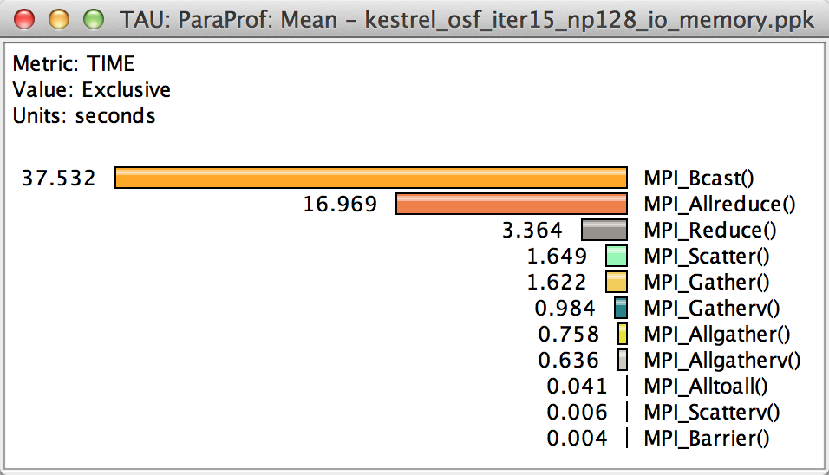
How Much Time is spent in Collectives?
Message sizes
Time spent in collectives
Notes:
What is the memory usage of the code?
When/where is memory allocated?
Are there any memory leaks?
What are the I/O characteristics?

Slide 34
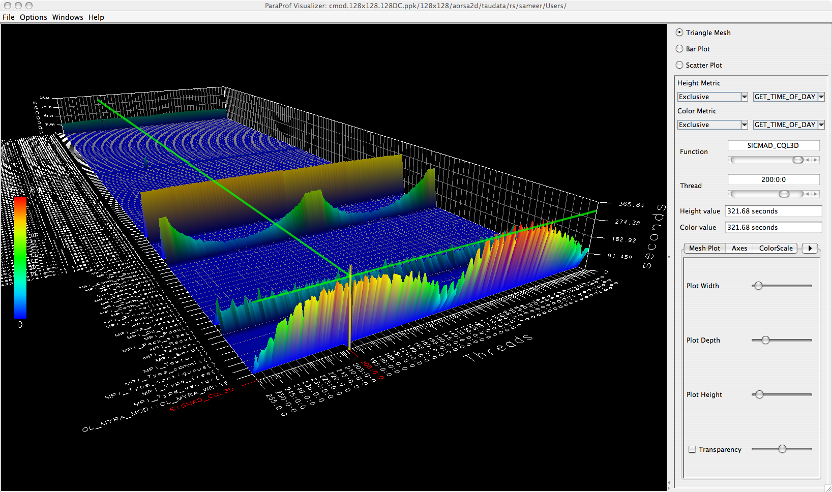
3D Profile Visualization
% paraprof (Windows → 3D Visualization)

Slide 35
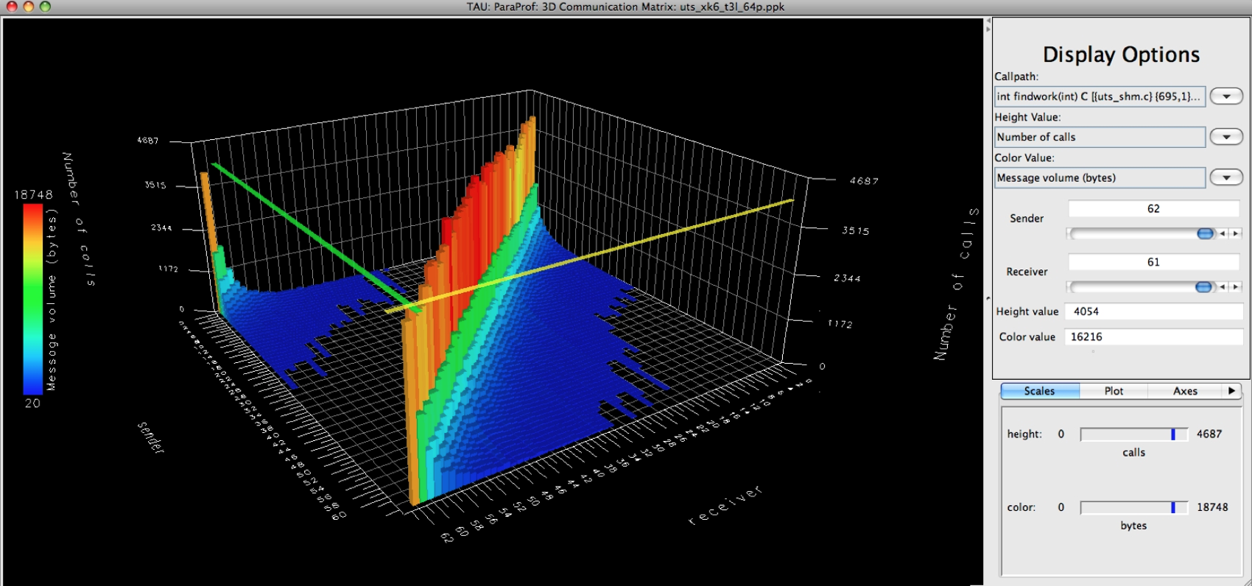
3D Communication Visualization
% qsub –env TAU_COMM_MATRIX=1 …
% paraprof (Windows → 3D Communication Matrix)

Slide 36
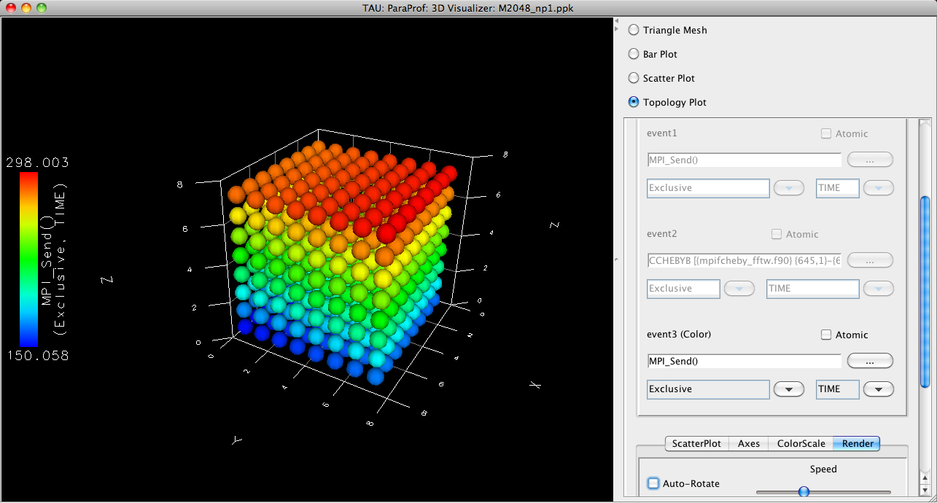
3D Topology Visualization
% paraprof (Windows → 3D Visualization → Topology Plot)
Notes:
MPI_Send on BG/Q

Slide 37
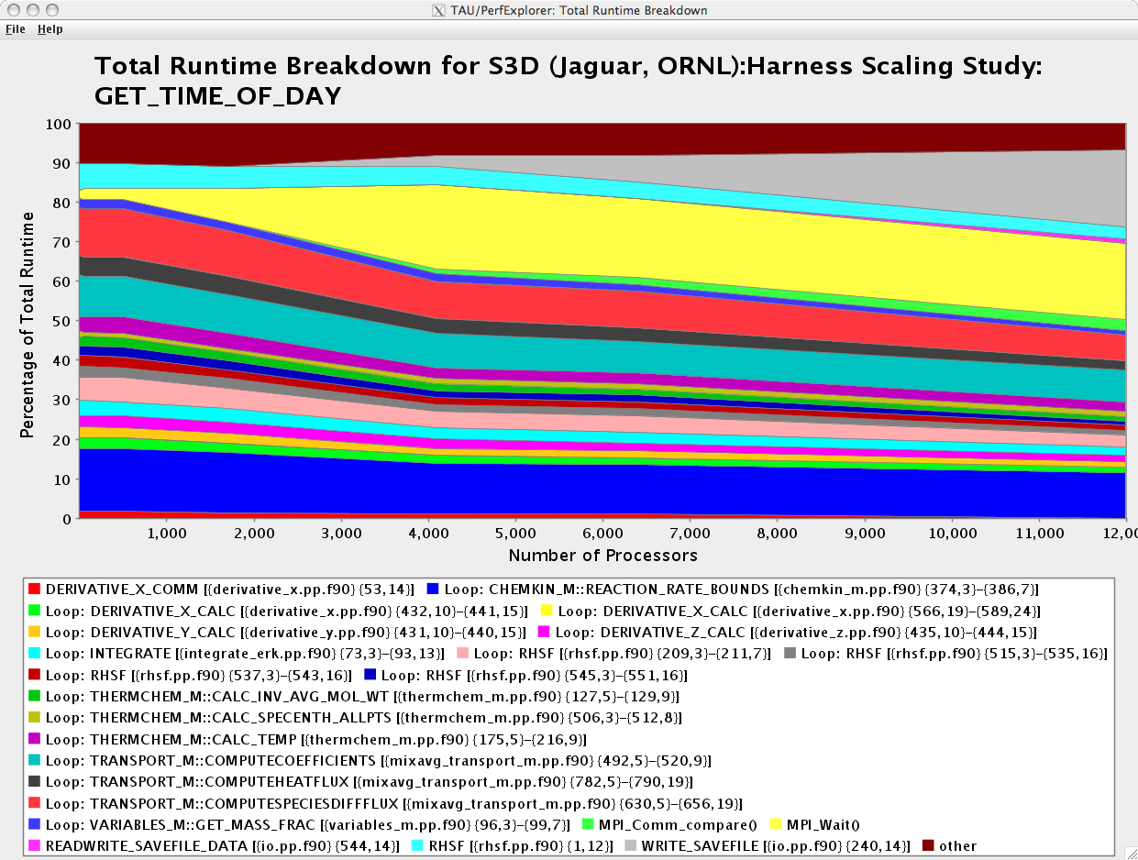
How Does Each Routine Scale?
WRITE_SAVEFILE
MPI_Waitall
% perfexplorer (Charts → Runtime Breakdown)

Slide 38
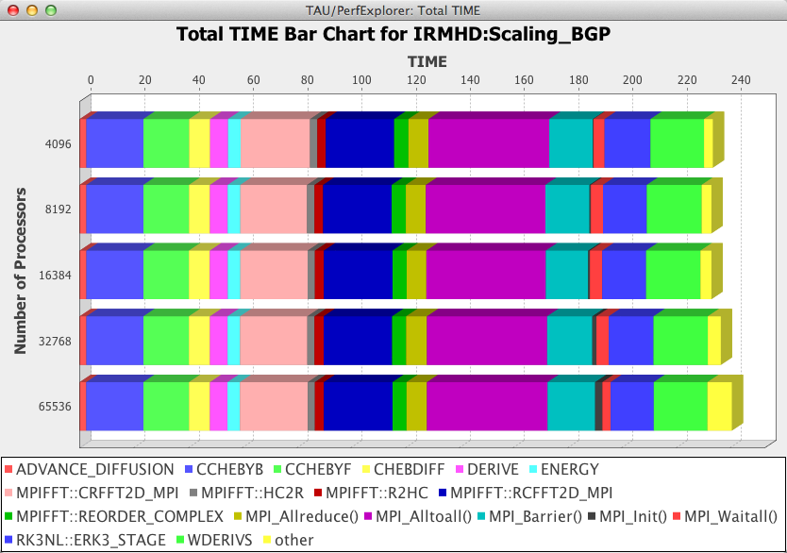
How Does Each Routine Scale?
% perfexplorer (Charts → Stacked Bar Chart)

Slide 39
Which Events Correlate with Runtime?
% perfexplorer (Charts → Correlate Events with Total Runtime)

Slide 40
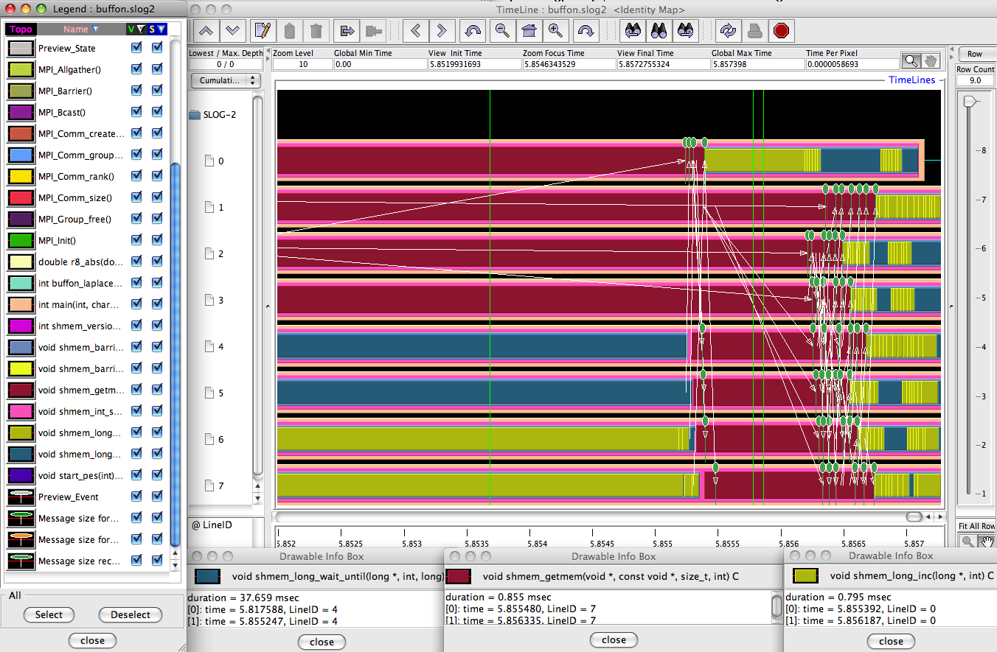
When do Events Occur?

Slide 41
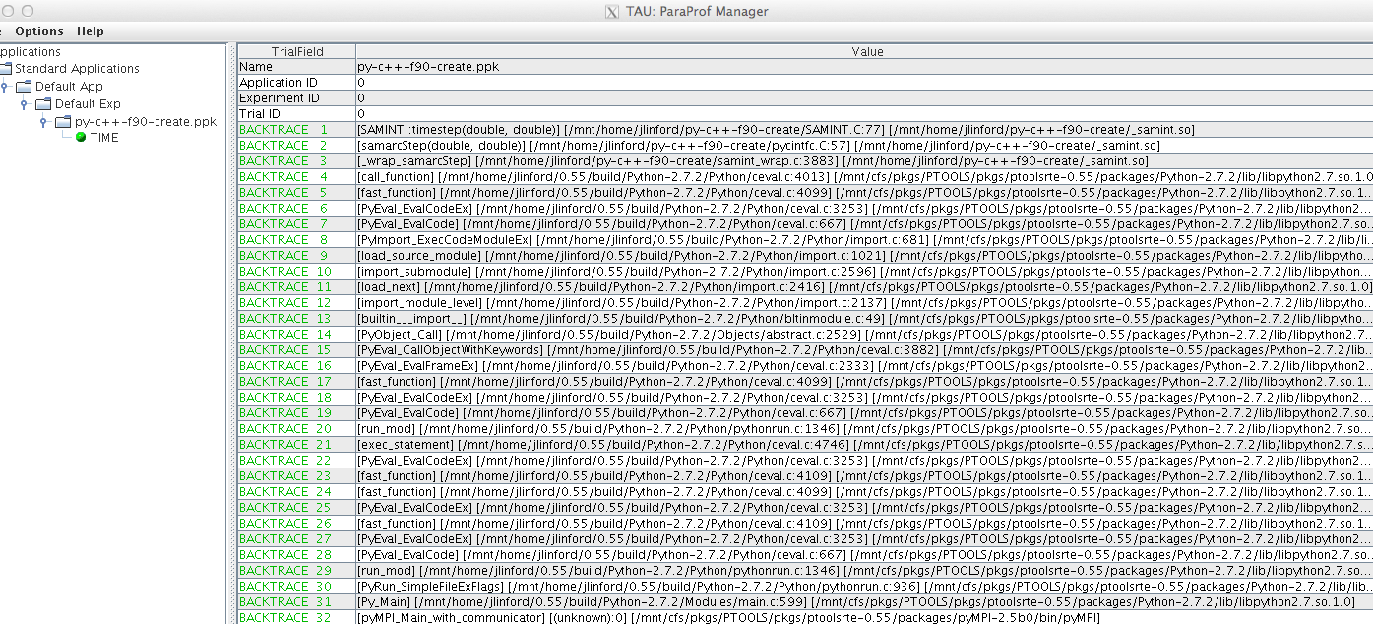
What Caused My Application to Crash?
% export TAU_TRACK_SIGNALS=1
% paraprof
Notes:
What caused the segfault?
What were the performance characteristics up to failure?
Which routines were or were not called?
Were there any memory errors?

Slide 42
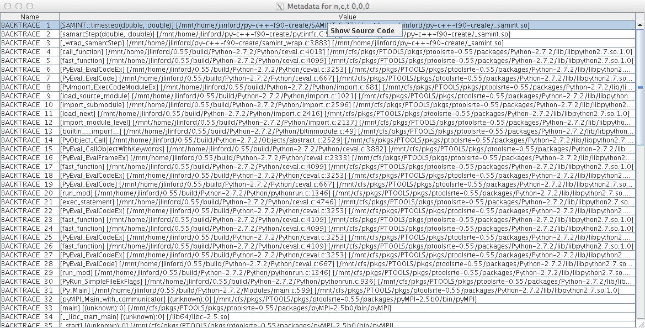
What Caused My Application to Crash?
Right-click to see source code

Slide 43
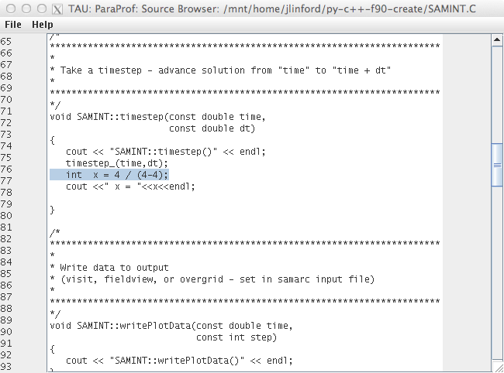
What Caused My Application to Crash?
Error shown in ParaProf Source Browser

Slide 44
Hands-on
Python Performance Evaluation

Slide 45
ParaTools Training Cluster
ssh -XY livetau@cerberus.nic.uoregon.edu
Password: ***********
Pick a number XX from [1, 39]
cd studentXX
tar xvzf ~/workshop-python.tgz
Training materials
~livetau/workshop-python.tgz
https://github.com/jlinford/workshop-python
http://www.paratools.com/emit15/TAU

Slide 46
Getting Started with TAU
Each configuration of TAU corresponds to a unique stub makefile (TAU_MAKEFILE) in the TAU installation directory
% ls $TAU/Makefile.*
Makefile.tau-icpc-papi-mpi-pdt
Makefile.tau-icpc-papi-ompt-mpi-pdt-openmp
Makefile.tau-icpc-papi-ompt-pdt-openmp
…
Makefile.tau-mpi-pthread-python-pdt
Makefile.tau-mpi-python-pdt
Makefile.tau-mpi-python-pdt-openmp
Makefile.tau-pthread-python-pdt
Makefile.tau-python-pdt
19 TAU Makefiles on cerberus.nic.uoregon.edu

Slide 47
Basic TAU Workflow
Choose your TAU_MAKEFILE:
  $ export TAU_MAKEFILE=
  $TAU/Makefile.tau-mpi-python-pdt
Use tau_f90.sh, tau_cxx.sh, etc. as compiler:
  $ mpif90 foo.f90
  changes to
  $ tau_f90.sh foo.f90
Edit Makefile or set compilers on command line:
$ make CC=tau_cc.sh
Execute application
Analyze performance data:
  pprof (for text based profile display)
  paraprof (for GUI)

Slide 48
TAU with Pure Python
$ cd workshop-python/00_matmult.py
$ python mm.py
Run with tau_python to generate profiles:
$ tau_python mm.py
$ ls profile.* # shows profile.0.0.0
$ paraprof --pack mm_py_flat.ppk
View the profiles:
$ pprof –a | less #Command line
$ paraprof #GUI (Java, X11)

Slide 49
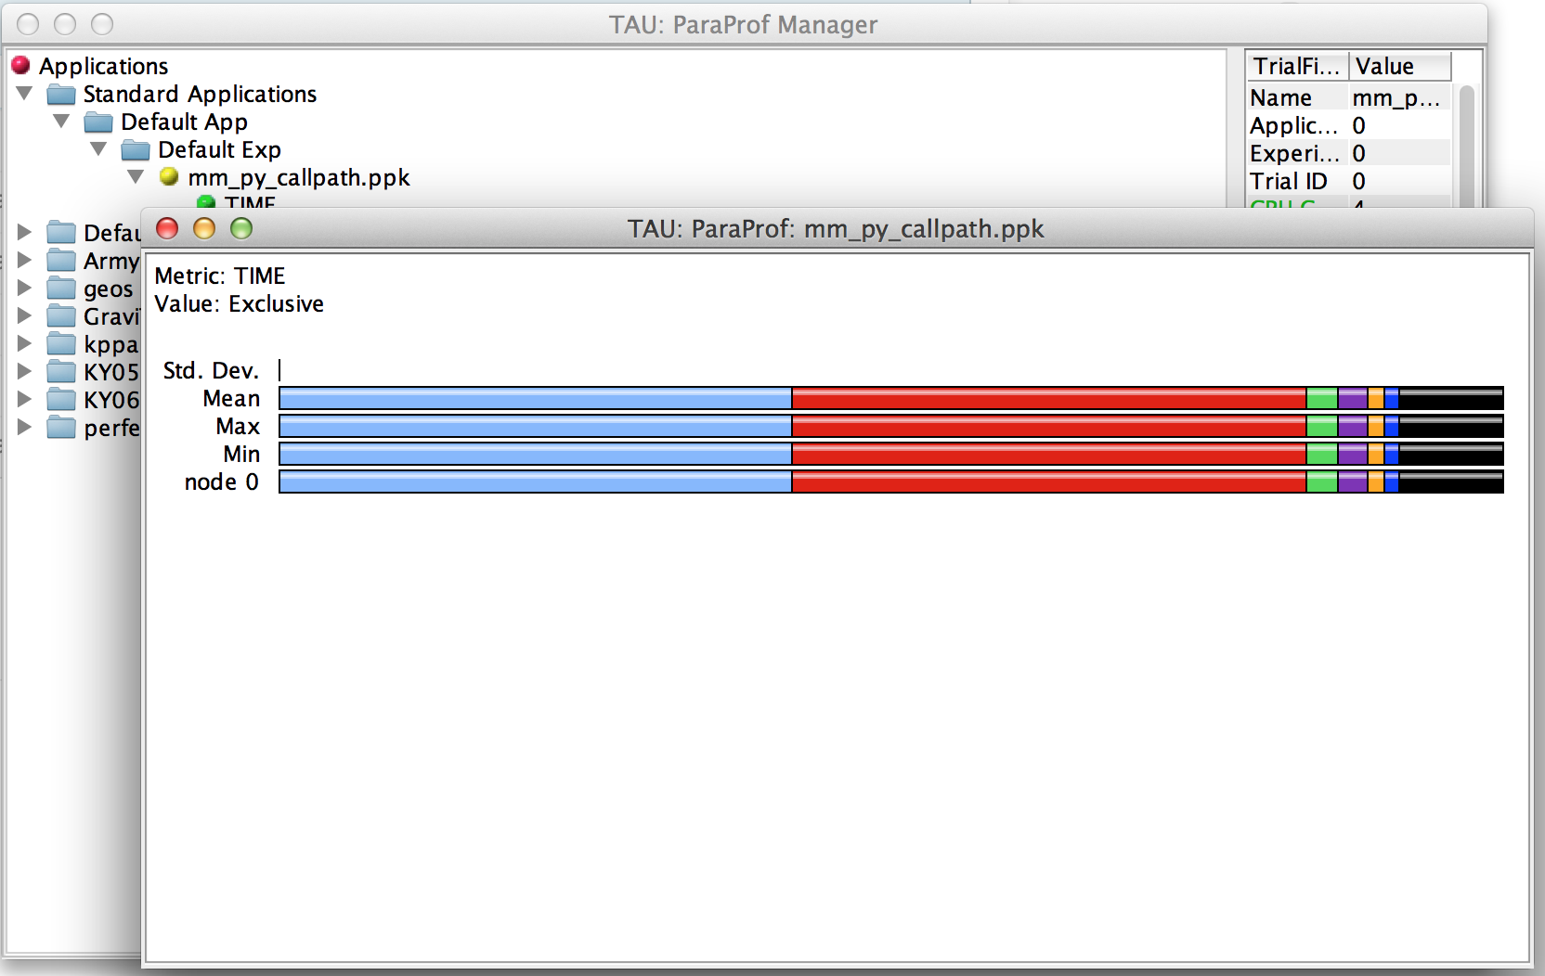
ParaProf Profile Visualizer
$ paraprof 00_matmult.py/analysis/mm_py_flat.ppk
Left-click on a node name to see data for that node
Right-click on a node name to see more options

Slide 50
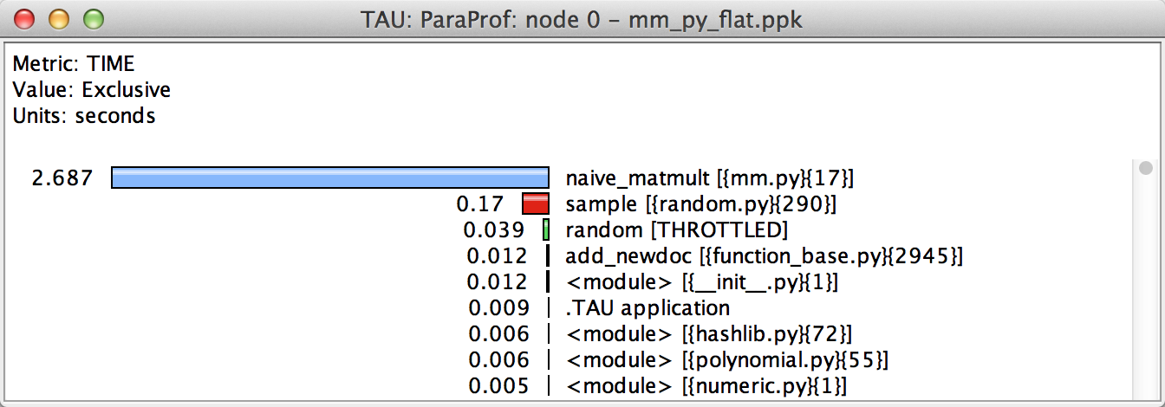
Exclusive Time in ParaProf
$ paraprof 00_matmult.py/analysis/mm_py_flat.ppk

Slide 51
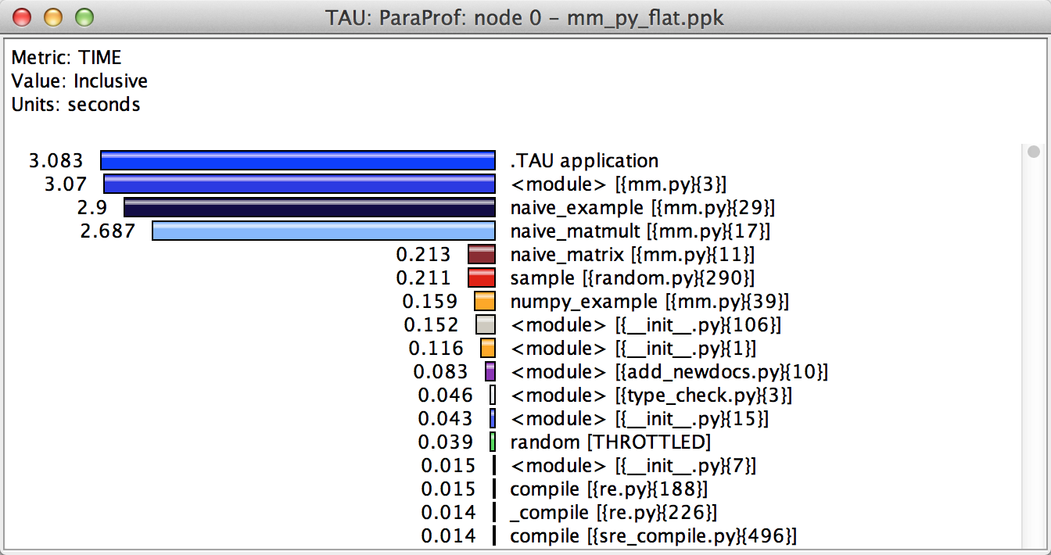
Inclusive Time in ParaProf

Slide 52
Callpath Profiles with Pure Python
For callpath profiles:
$ export TAU_CALLPATH=1
$ export TAU_CALLPATH_DEPTH=10
$ tau_python mm.py
TAU_CALLPATH_DEPTH controls the depth of the recorded callpath. “10” is usually more than enough.

Slide 53
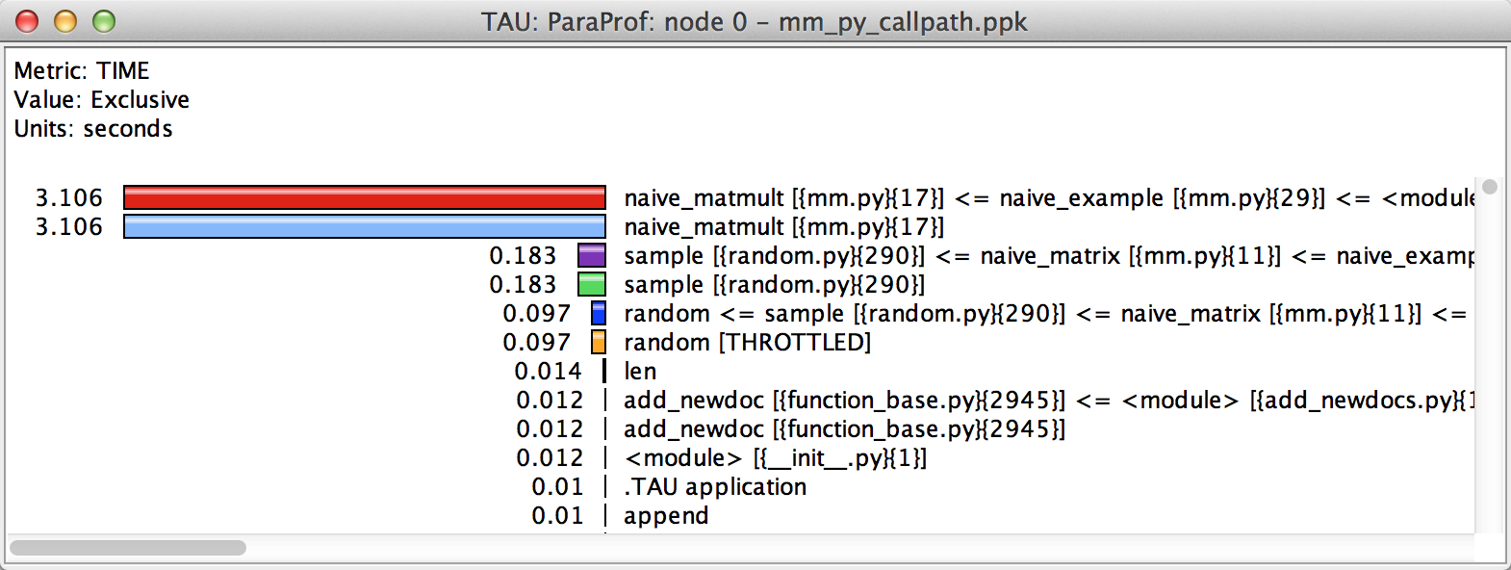
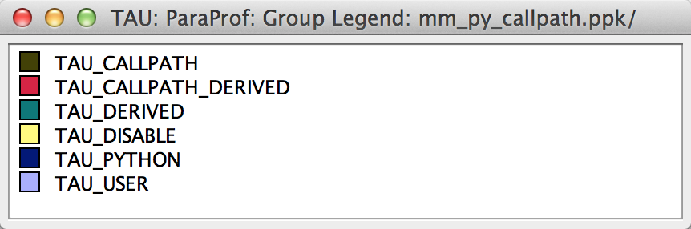
Callpath Profiles in ParaProf
Windows | Group Legend ➔
Right-click to hide groups

Slide 54
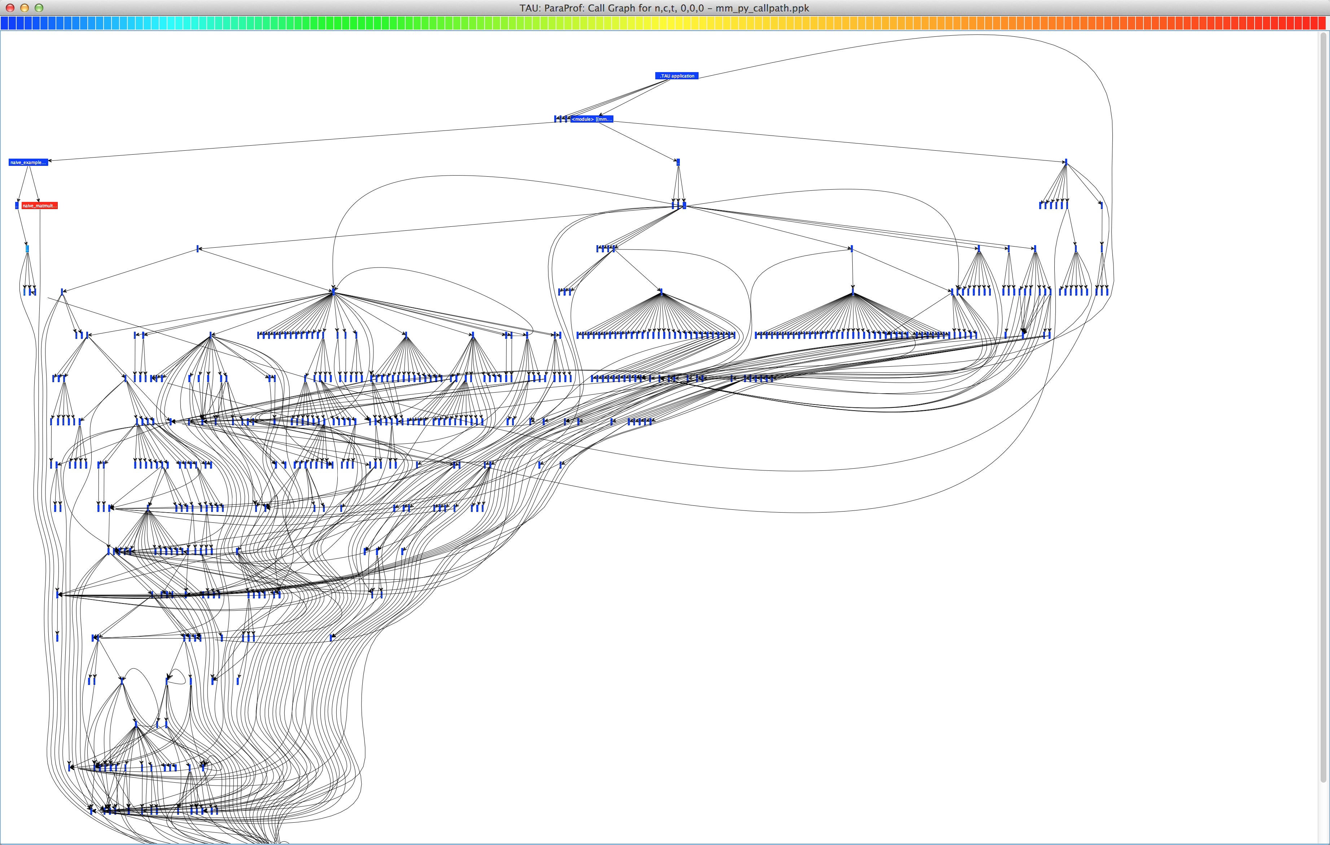
Callgraph in ParaProf

Slide 55
Callgraph in ParaProf
Naïve method
Numpy method

Slide 56
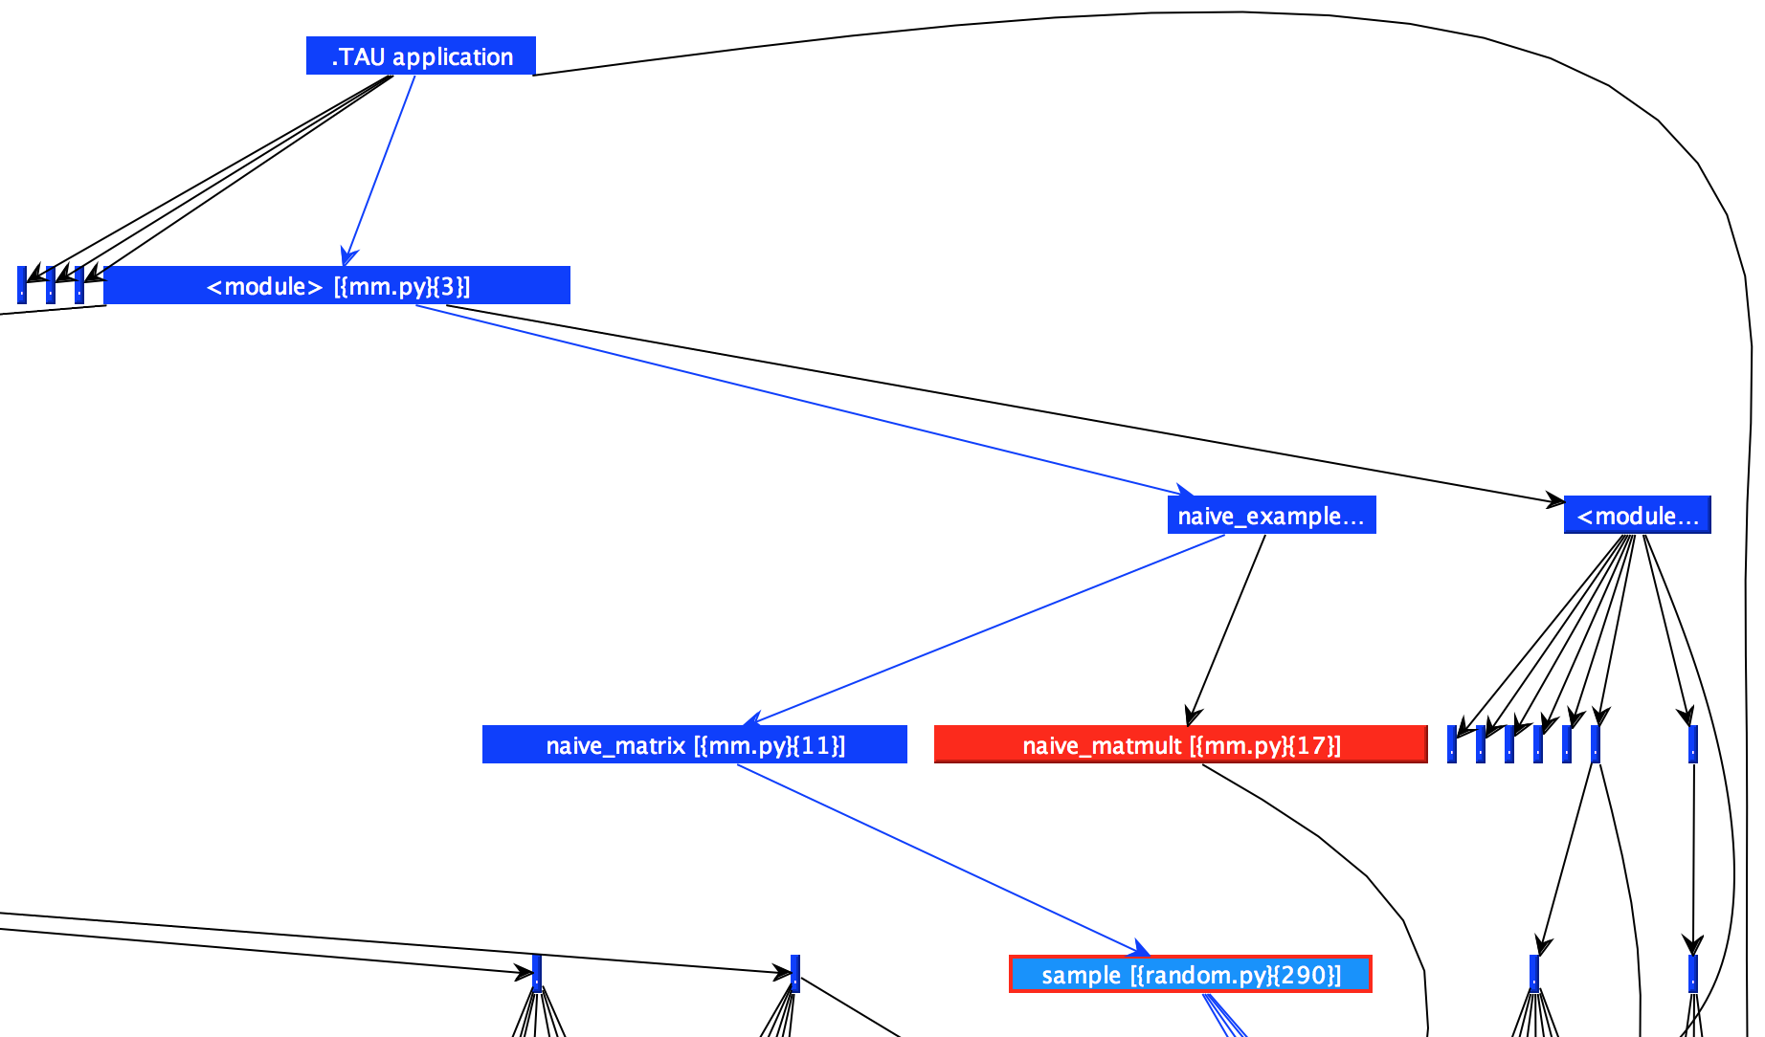
Callgraph in ParaProf

Slide 57
Traces with Pure Python
To generate traces:
$ unset TAU_CALLPATH #recommended
$ export TAU_TRACE=1
$ tau_python mm.py
Trace files must be post-processed:
$ tau_treemerge.pl
$ tau2slog2 tau.trc tau.edf –o \
mm_py.slog2
$ jumpshot mm_py.slog2

Slide 58
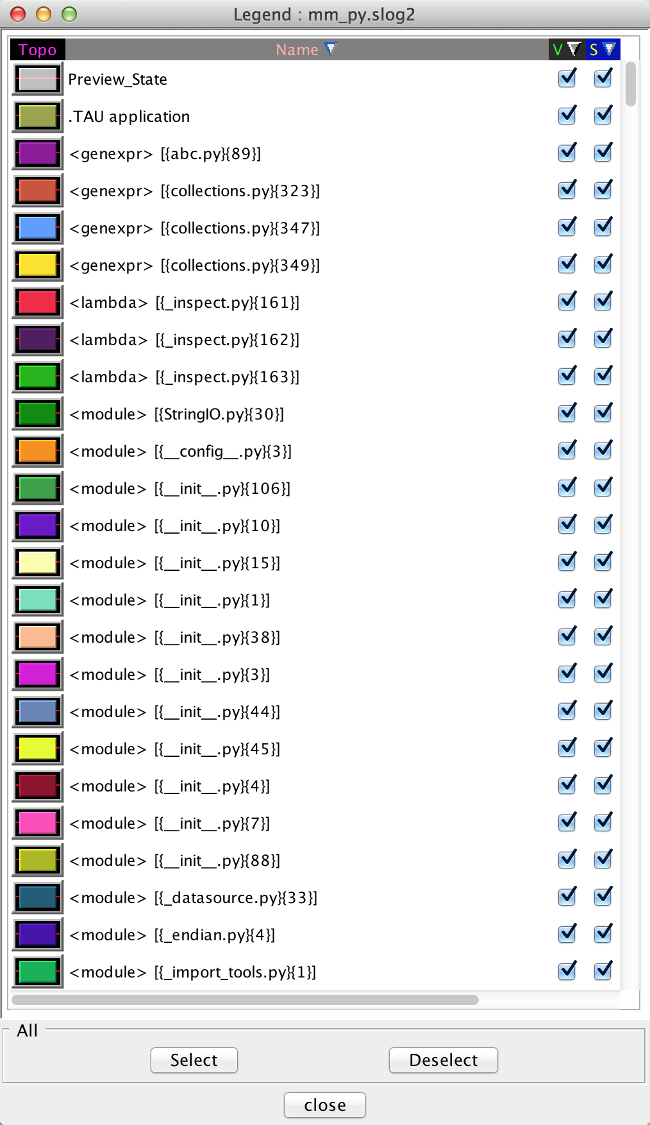
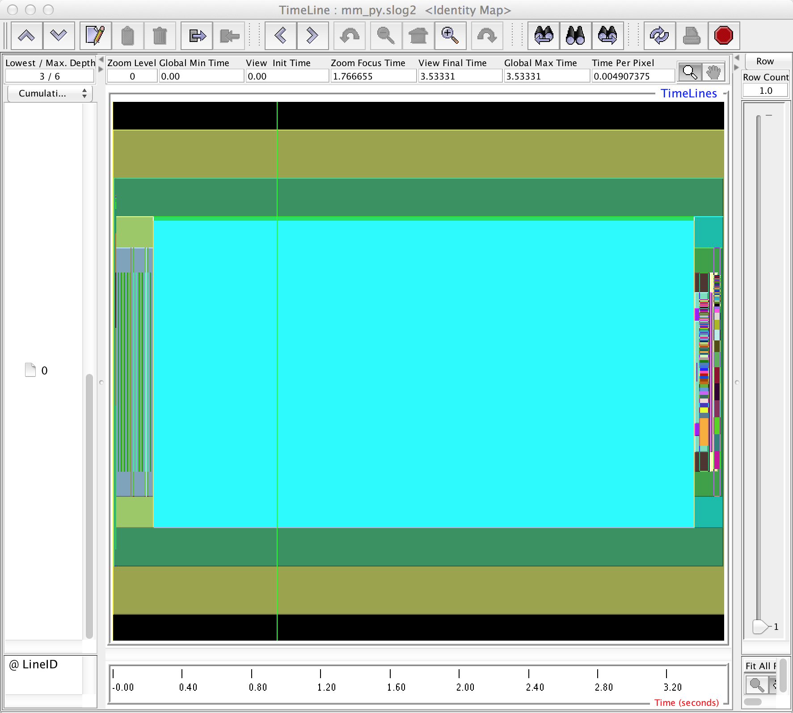
Jumpshot Trace Viewer

Slide 59
Public Service Annoucement
Don’t forget to clean your environment!
(Some folks write scripts)
Show all TAU environment variables:
$ env | grep TAU
Unset the ones you don’t need anymore:
$ unset TAU_TRACE
$ unset TAU_CALLPATH
etc.

Slide 60
Hands-on: native languages
Python Performance Evaluation

Slide 61
TAU with C/C++
$ cd workshop-python/01_matmult.c
$ make CC=tau_cc.sh
Run normally to generate profiles:
$ mpirun -np 4 ./matmult
$ ls profile.* # Shows four files
$ paraprof --pack mm_c_flat.ppk
View the profiles:
pprof –a | less #Command line
paraprof #GUI (Java, X11)

Slide 62
TAU with Fortran
$ cd workshop-python/02_matmult.f90
$ make
Run normally to generate profiles:
$ mpirun -np 4 ./matmult
$ ls profile.* # Shows four files
$ paraprof --pack mm_f90_flat.ppk
View the profiles:
pprof –a | less #Command line
paraprof #GUI (Java, X11)

Slide 63
Hands-on: Python+MPI (mpi4py)
Python Performance Evaluation

Slide 64
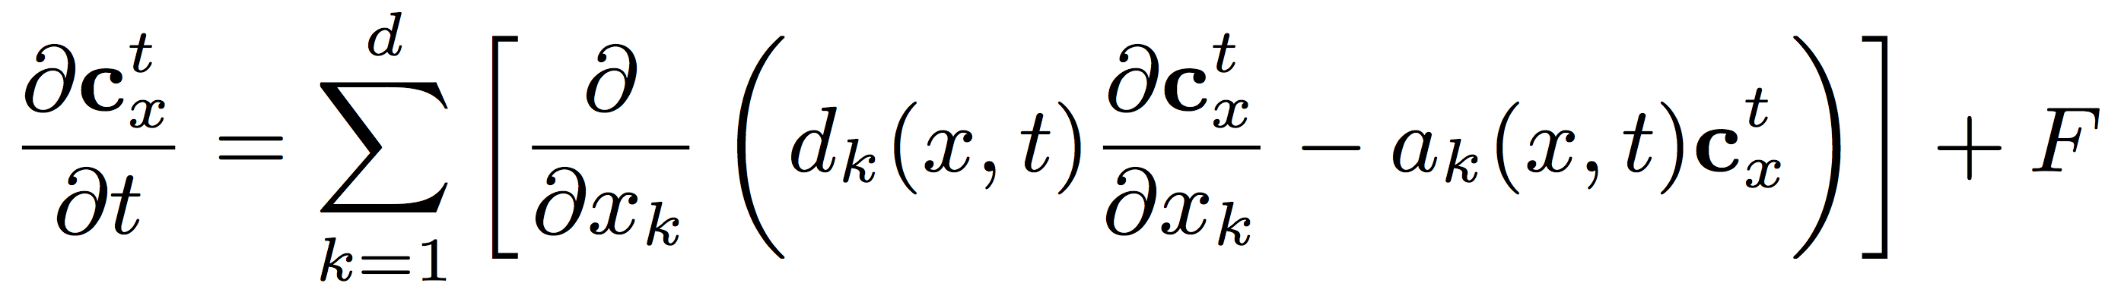
FIXEDGRID
A simple chemical transport model in Python
Advection: Upwind-biased 2nd order finite differences
Diffusion: 3rd order finite differences
Chemistry: Rosenbrock time-stepping integrator

Slide 65
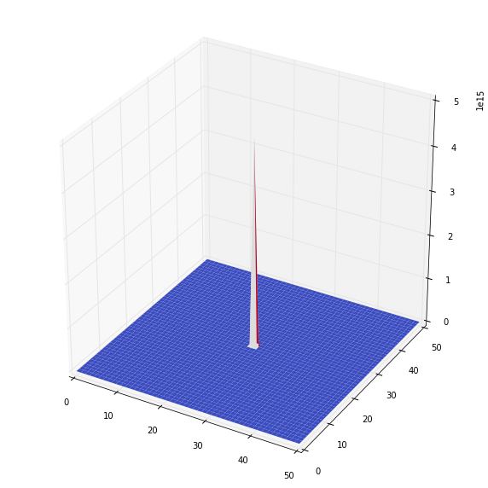
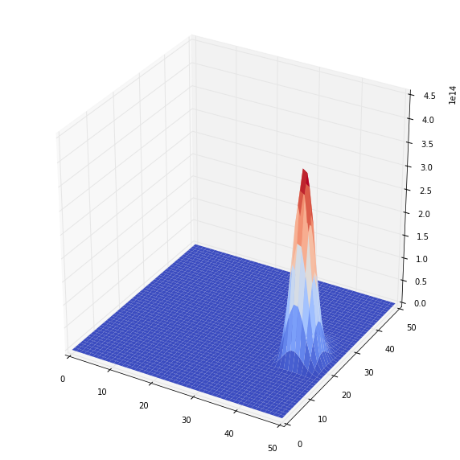
FIXEDGRID
TIME = 0
TIME = 900 seconds

Slide 66
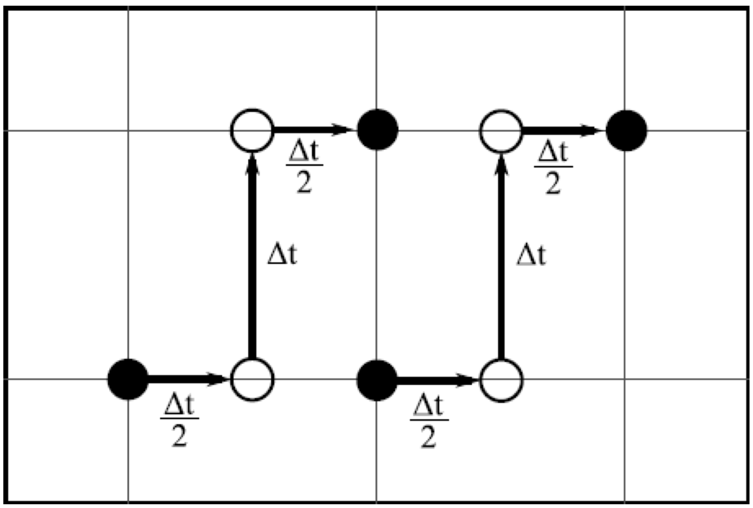
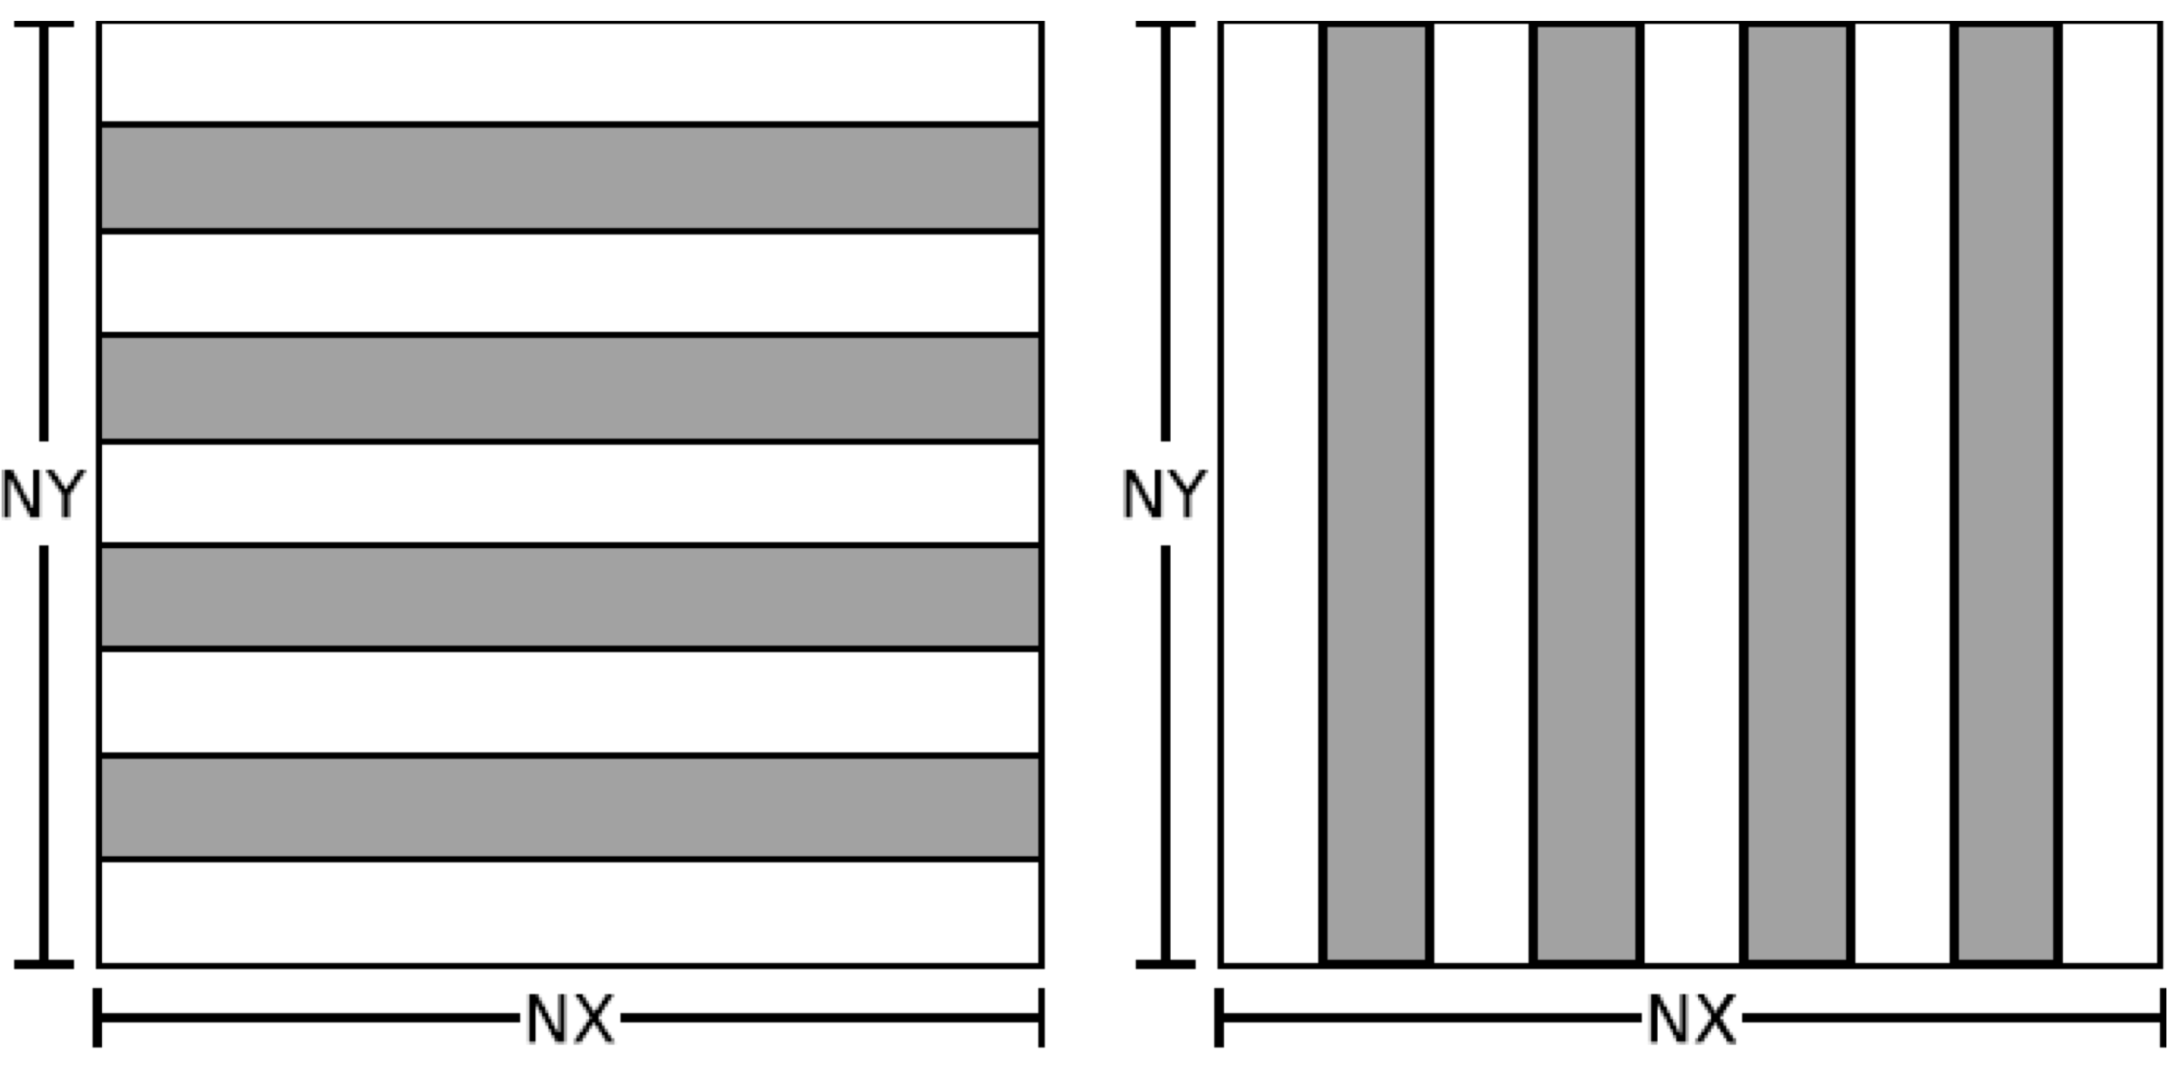
2nd Order Dimension Split in FIXEDGRID

Slide 67
MPI in FIXEDGRID
MPI Rank 0
MPI Rank 1
MPI Rank 2
MPI Rank 3

Slide 68
TAU with mpi4py
$ cd 04_fixedgrid-mpi.py
$ mpirun –np 4 python fixedgrid.py
Run with tau_exec and wrapper.py to generate profiles:
$ mpirun -np 4 tau_exec -T python,mpi \
python wrapper.py
View the profiles:
pprof –a | less #Command line
paraprof #GUI (Java, X11)

Slide 69
Multiple Layers of Instrumentation
$ mpirun -np 4 \
tau_exec –T python,mpi \
python wrapper.py
a.k.a
$ “Run my code” \
“Use TAU to measure MPI” \
“Within that TAU instance, instrument python”

Slide 70
wrapper.py for Python Instrumentation
$ cat wrapper.py
import tau
tau.run('import fixedgrid')
This approach works for many Python packages, not just mpi4py

Slide 71
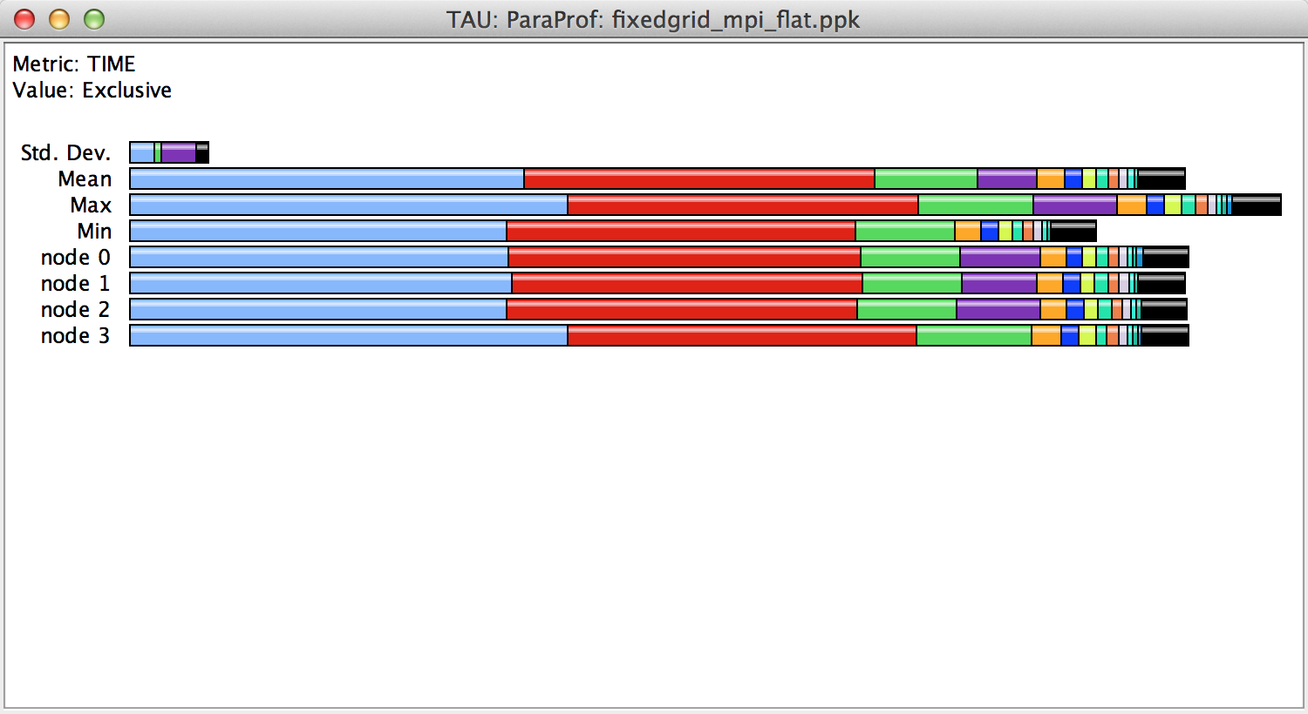
FIXEDGRID Profile
Left-click on a node name to see data for that node
Right-click on a node name to see more options

Slide 72
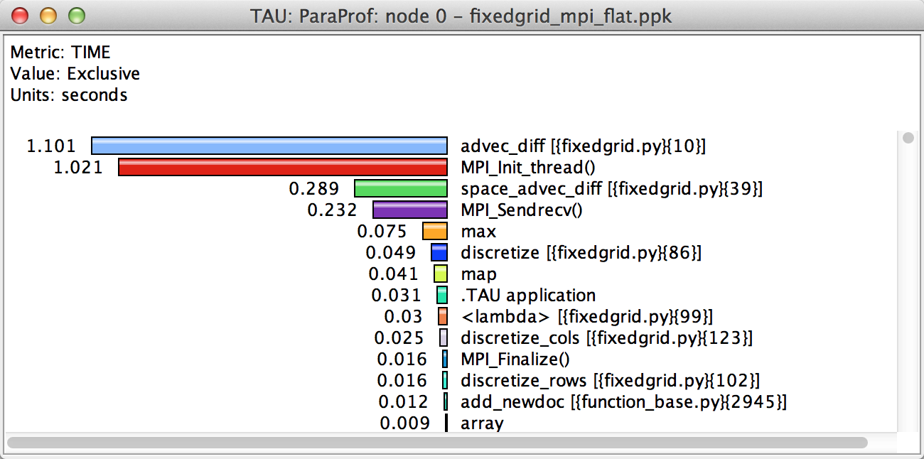
FIXEDGRID Profile

Slide 73
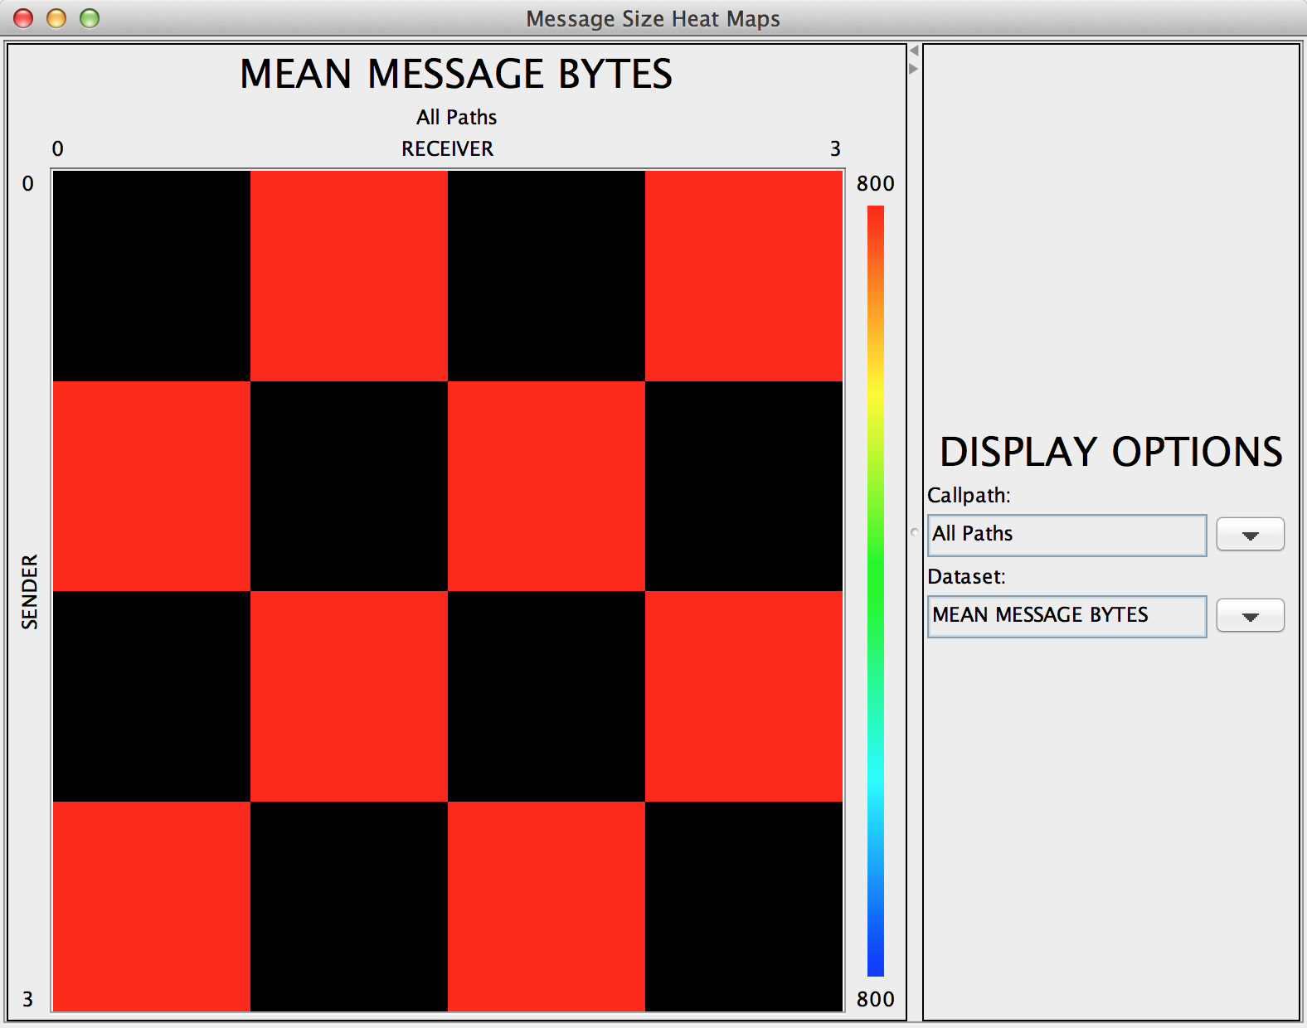
FIXEDGRID Communication Matrix
$ export TAU_COMM_MATRIX=1
$ mpirun -np 4 tau_exec -T python,mpi python wrapper.py
In Paraprof: Windows | Communication Matrix

Slide 74
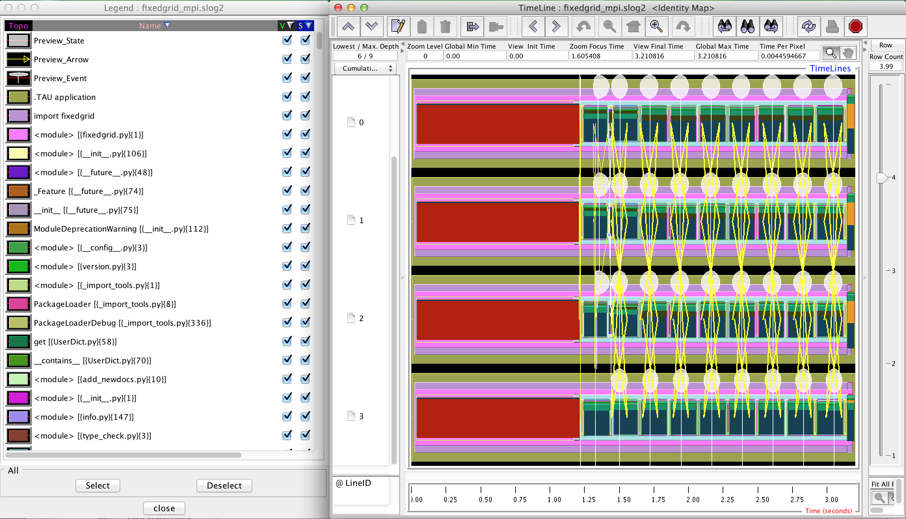
FIXEDGRID Trace Shows Communication
$ jumpshot fixedgrid_mpi.slog2

Slide 75
PerfExplorer
$ cd 04_fixedgrid-mpi.py/analysis
$ taudb_configure --create-default
$ taudb_loadtrial fixedgrid_np1.ppk
$ taudb_loadtrial fixedgrid_np2.ppk
$ taudb_loadtrial fixedgrid_np3.ppk
…
$ perfexplorer

Slide 76
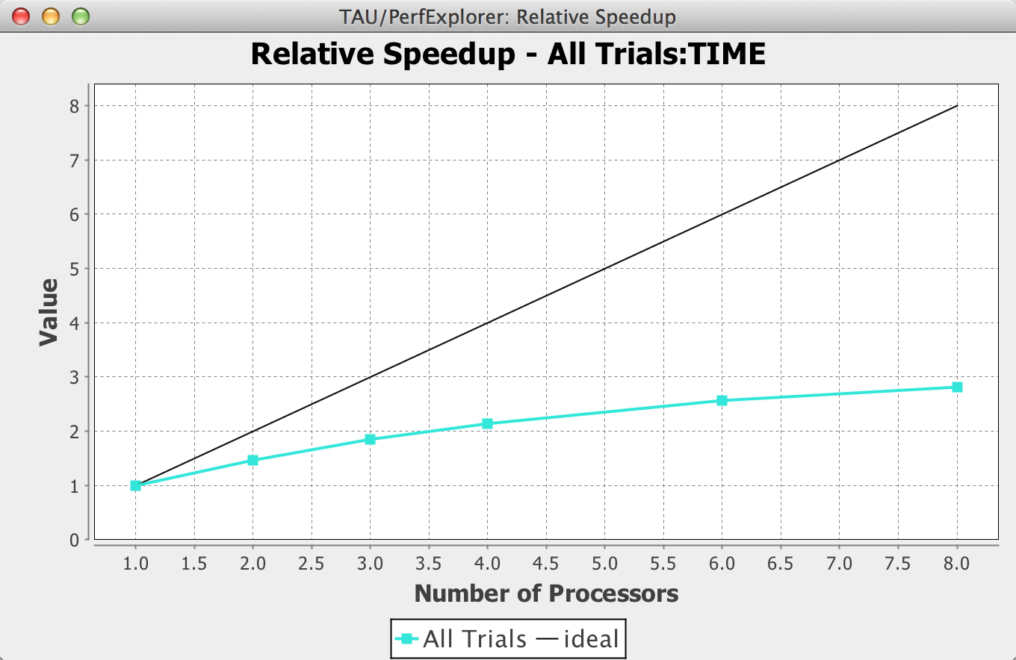
Relative Speedup Chart
In PerfExplorer: Charts | Relative Speedup

Slide 77
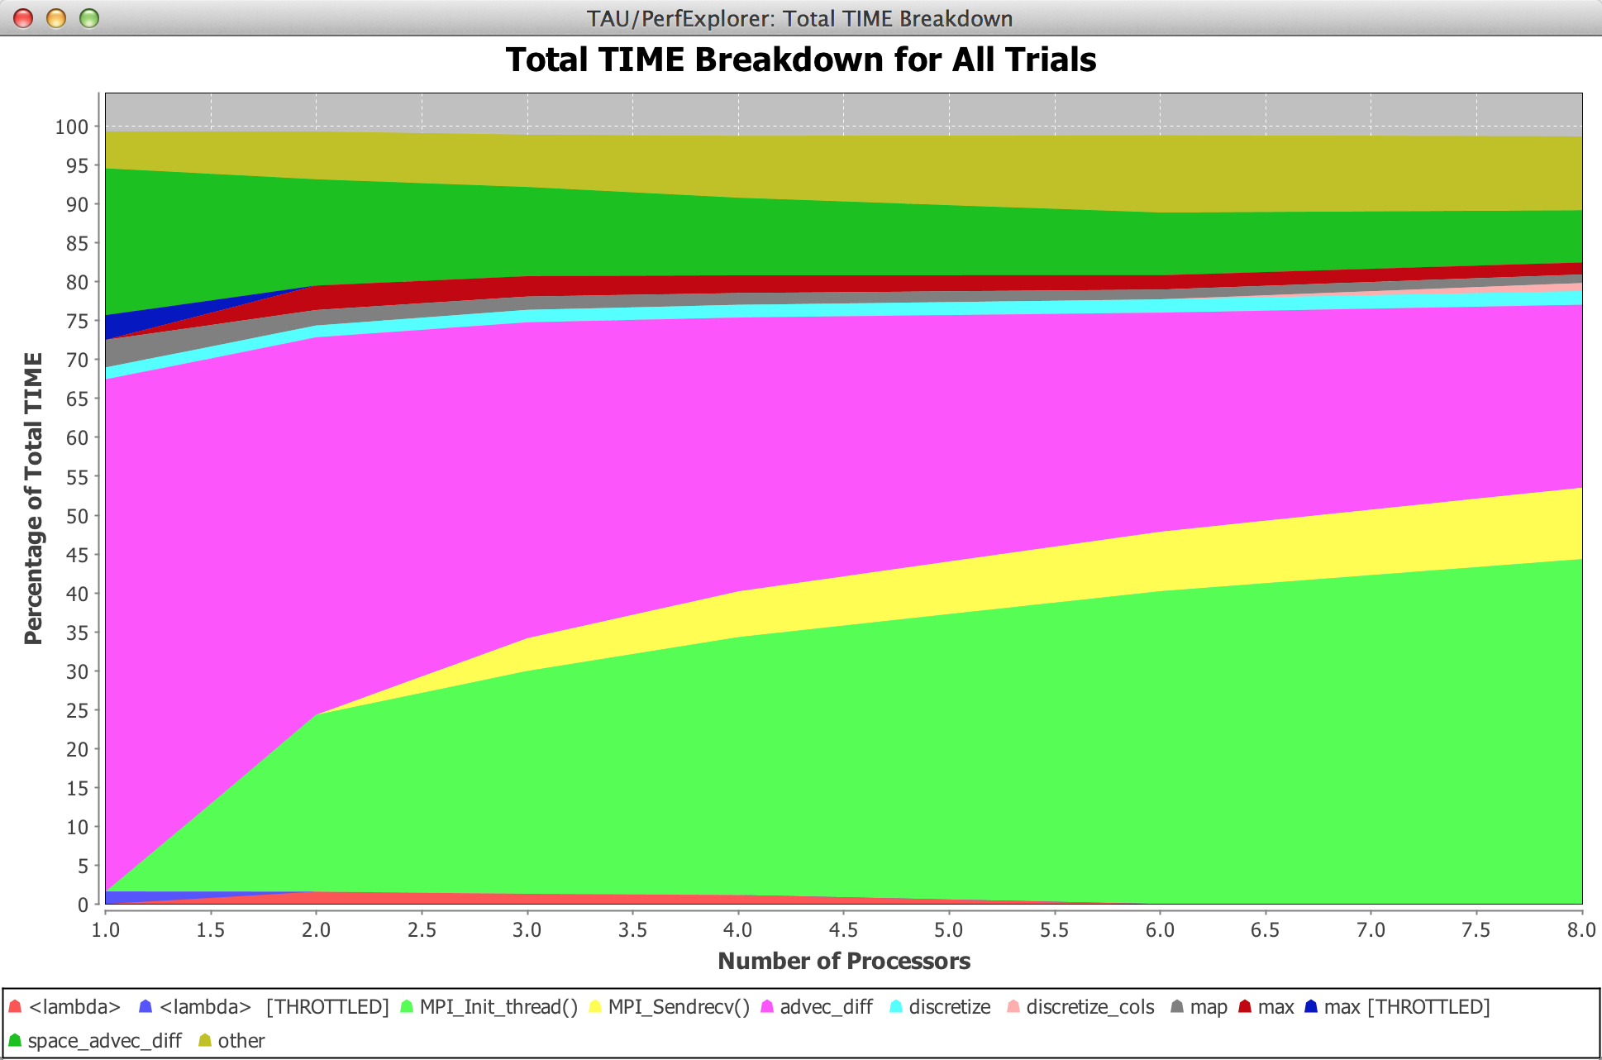
Runtime Breakdown Chart
In PerfExplorer: Charts | Runtime Breakdown

Slide 78
Hands-on: Python+X
(because we can)
Python Performance Evaluation

Slide 79



Kppa: The Kinetic PreProcessor Accelerated
CUDA
C
Architecture
Domain Specific
Language
Fortran
Python
Serial
Multi-core
Code
optimized
Kppa
GPGPU
Intel MIC
Lexical parser
Analysis
Code generation

Slide 80
TAU + Python + mpi4py + C + OpenMP
$ cd 05_fixedgrid-chem.c_py
$ make
$ mpirun –np 4 python fixedgrid.py
Run with tau_exec and wrapper.py to generate profiles:
$ make clean
$ make CC=tau_cc.sh
$ mpirun -np 4 tau_exec -T python,mpi,openmp \
python wrapper.py

Slide 81
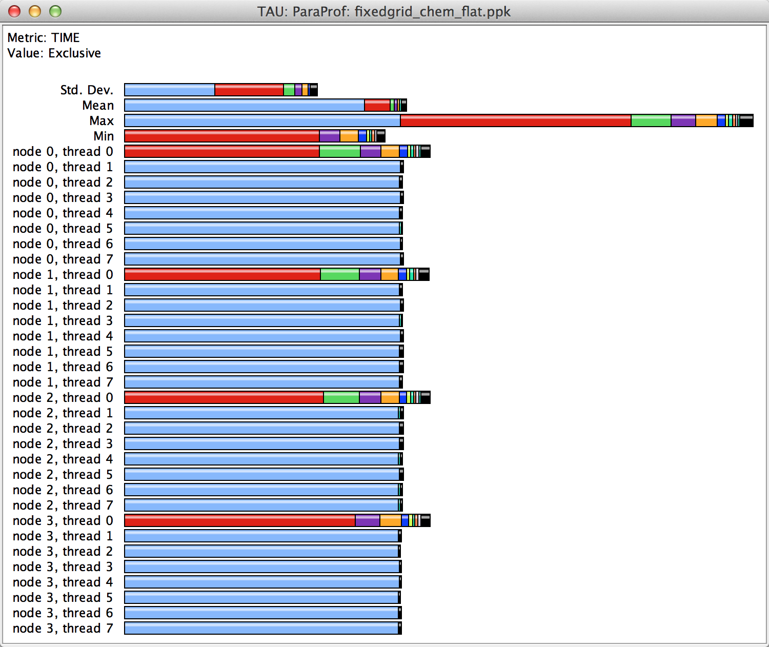
MPI + OpenMP Profiles

Slide 82
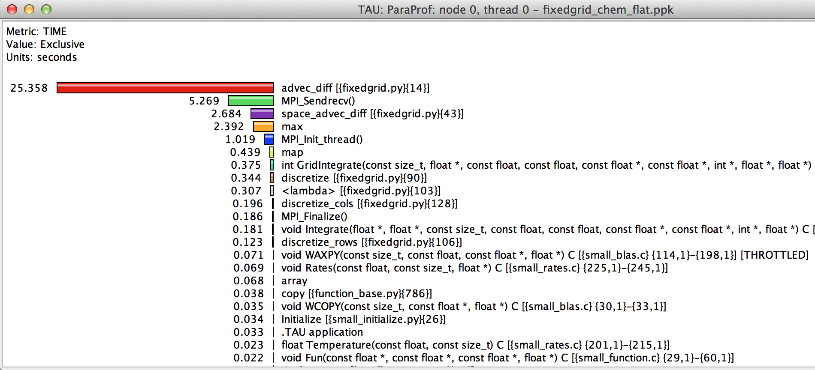
Rank 0, Thread 0

Slide 83
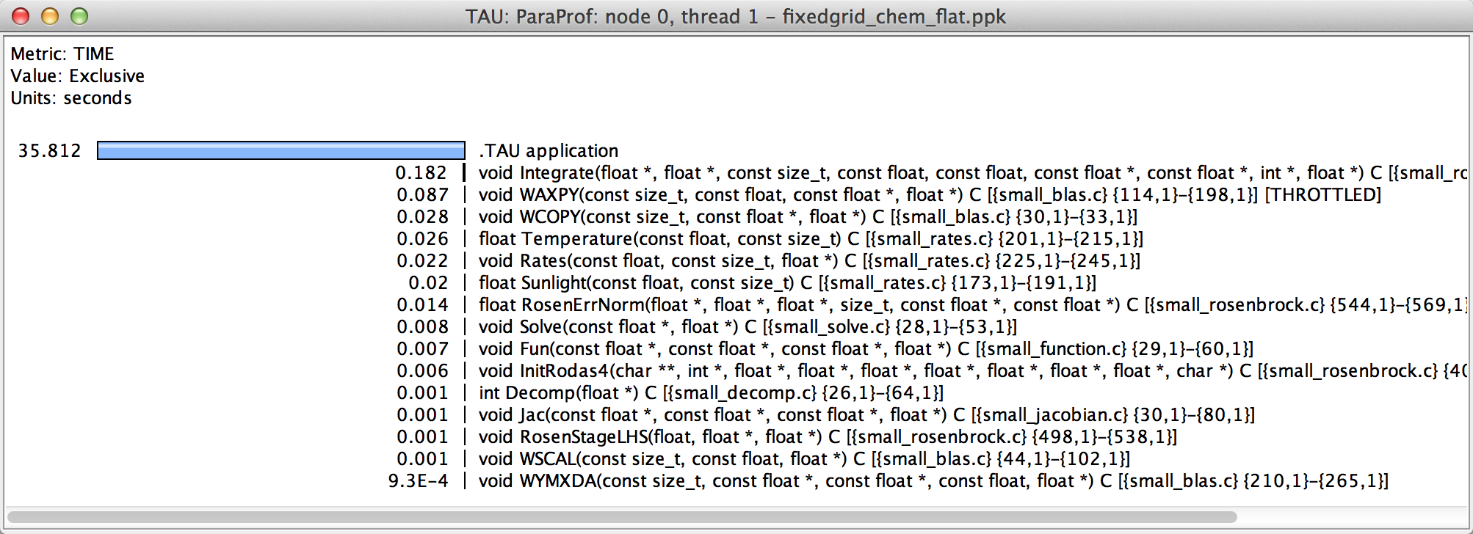
Rank 0, Thread 1

Slide 84
Hands-on: Debugging
Python Performance Evaluation

Slide 85
TAU + Python + mpi4py + C + OpenMP
$ cd 06_debugging
$ make
$ tau_python samarcrun.py
TAU: Caught signal 8 (Floating point exception), …
To see stack trace on command line:
$ paraprof -d | grep BACKTRACE

Slide 86
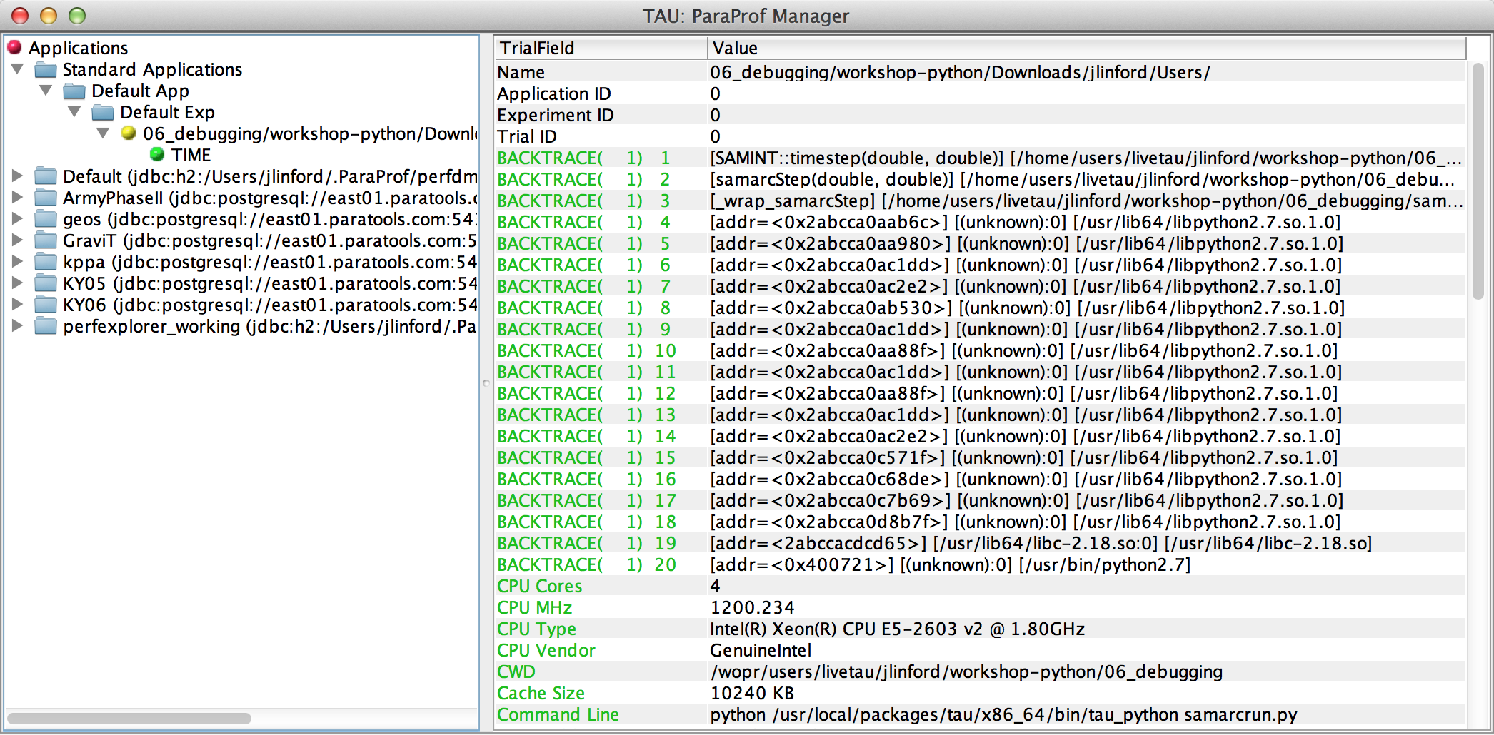
Backtrace Shown in ParaProf

Slide 87
Hands-on: tau and ipython
Python Performance Evaluation

Slide 88

TAU in IPython Notebook

Slide 89
Conclusion
Python Performance Evaluation

Slide 90

Download TAU from U. Oregon
http://tau.uoregon.edu
http://www.hpclinux.com [LiveDVD]
Free download, open source, BSD license

Slide 91
















Acknowledgements
Department of Energy
  Office of Science
  Argonne National Laboratory
  Oak Ridge National Laboratory
  NNSA/ASC Trilabs (SNL, LLNL, LANL)
HPCMP DoD PETTT Program
National Science Foundation
  Glassbox, SI-2
University of Tennessee
    University of New Hampshire
      Jean Perez, Benjamin Chandran
University of Oregon
  Allen D. Malony, Sameer Shende
  Kevin Huck, Wyatt Spear
TU Dresden
  Holger Brunst, Andreas Knupfer
  Wolfgang Nagel
Research Centre Jülich
  Bernd Mohr
  Felix Wolf

Slide 92
Reference
TAU Performance System

Slide 93
Online References
PAPI:
  PAPI documentation is available from the PAPI website:
  http://icl.cs.utk.edu/papi/
TAU:
  TAU Users Guide and papers available from the TAU website: http://tau.uoregon.edu/
VAMPIR:
  VAMPIR website:
  http://www.vampir.eu/
Scalasca:
  Scalasca documentation page:
  http://www.scalasca.org/
Eclipse PTP:
  Documentation available from the Eclipse PTP website:
  http://www.eclipse.org/ptp/

Slide 94
Compiling Fortran Codes with TAU
If your Fortran code uses free format in .f files (fixed is default for .f):
% export TAU_OPTIONS='-optPdtF95Opts="-R free" -optVerbose'
To use the compiler based instrumentation instead of PDT (source-based):
% export TAU_OPTIONS='-optCompInst -optVerbose'
If your Fortran code uses C preprocessor directives (#include, #ifdef, #endif):
% export TAU_OPTIONS='-optPreProcess –optVerbose'
To use an instrumentation specification file:
% export TAU_OPTIONS=
'-optTauSelectFile=select.tau -optVerbose -optPreProcess’
Example select.tau file
  BEGIN_INSTRUMENT_SECTION
  loops file="*" routine="#"
  memory file="foo.f90" routine=”#"
  io file="abc.f90" routine="FOO"
  END_INSTRUMENT_SECTION

Slide 95
Generate a PAPI profile with 2 or more counters
% export TAU_MAKEFILE=$TAU/Makefile.tau-papi-mpi-pdt
% export TAU_OPTIONS=‘-optTauSelectFile=select.tau –optVerbose’
% cat select.tau
BEGIN_INSTRUMENT_SECTION
loops routine=“#”
END_INSTRUMENT_SECTION
% export PATH=$TAU_ROOT/bin:$PATH
% make F90=tau_f90.sh
(Or edit Makefile and change F90=tau_f90.sh)
%
% export TAU_METRICS=TIME:PAPI_FP_INS:PAPI_L1_DCM
% mpirun -np 4 ./a.out
% paraprof -–pack app.ppk
Move the app.ppk file to your desktop.
% paraprof app.ppk
Choose Options -> Show Derived Metrics Panel -> “PAPI_FP_INS”, click “/”, “TIME”, click “Apply” and choose the derived metric.

Slide 96
Tracking I/O
% export TAU_MAKEFILE=$TAU/Makefile.tau-papi-mpi-pdt
% export PATH=$TAU_ROOT/bin:$PATH
% export TAU_OPTIONS=‘-optTrackIO –optVerbose’
% make CC=tau_cc.sh CXX=tau_cxx.sh F90=tau_f90.sh
% mpirun –n 4 ./a.out
% paraprof –pack ioprofile.ppk
% export TAU_TRACK_IO_PARAMS=1
% mpirun –n 4 ./a.out

Slide 97
Installing and Configuring TAU
Installing PDT:
  wget http://tau.uoregon.edu/pdt.tgz
  ./configure –prefix=<dir>; make ; make install
Installing TAU:
  wget http://tau.uoregon.edu/tau.tgz
  ./configure -bfd=download -pdt=<dir> -papi=<dir> ...
  make install
Using TAU:
  export TAU_MAKEFILE=<taudir>/<arch>/lib/Makefile.tau-<TAGS>
  make CC=tau_cc.sh CXX=tau_cxx.sh F90=tau_f90.sh

Slide 98
Compile-Time Options (TAU_OPTIONS)
% tau_compiler.sh
  -optVerbose Turn on verbose debugging messages
  -optCompInst Use compiler based instrumentation
  -optNoCompInst Do not revert to compiler instrumentation if source instrumentation fails.
  ﻿-optTrackIO Wrap POSIX I/O call and calculates vol/bw of I/O operations
  ﻿-optMemDbg Runtime bounds checking (see TAU_MEMDBG_* env vars)
  -optKeepFiles Does not remove intermediate .pdb and .inst.* files
  -optPreProcess Preprocess sources (OpenMP, Fortran) before instrumentation
  -optTauSelectFile=”<file>" Specify selective instrumentation file for tau_instrumentor
  -optTauWrapFile=”<file>" Specify path to link_options.tau generated by tau_gen_wrapper
  -optHeaderInst Enable Instrumentation of headers
  -optTrackUPCR Track UPC runtime layer routines (used with tau_upc.sh)
  -optPdtF95Opts="" Add options for Fortran parser in PDT (f95parse/gfparse) …

Slide 99
Runtime Environment Variables
Environment Variable | Default | Description
TAU_TRACE | 0 | Setting to 1 turns on tracing
TAU_CALLPATH | 0 | Setting to 1 turns on callpath profiling
TAU_TRACK_MEMORY_LEAKS | 0 | Setting to 1 turns on leak detection (for use with –optMemDbg or tau_exec)
TAU_MEMDBG_PROTECT_ABOVE | 0 | Setting to 1 turns on bounds checking for dynamically allocated arrays. (Use with –optMemDbg or tau_exec –memory_debug).
TAU_CALLPATH_DEPTH | 2 | Specifies depth of callpath. Setting to 0 generates no callpath or routine information, setting to 1 generates flat profile and context events have just parent information (e.g., Heap Entry: foo)
TAU_TRACK_IO_PARAMS | 0 | Setting to 1 with –optTrackIO or tau_exec –io captures arguments of I/O calls
TAU_TRACK_SIGNALS | 0 | Setting to 1 generate debugging callstack info when a program crashes
TAU_COMM_MATRIX | 0 | Setting to 1 generates communication matrix display using context events
TAU_THROTTLE | 1 | Setting to 0 turns off throttling. Enabled by default to remove instrumentation in lightweight routines that are called frequently
TAU_THROTTLE_NUMCALLS | 100000 | Specifies the number of calls before testing for throttling
TAU_THROTTLE_PERCALL | 10 | Specifies value in microseconds. Throttle a routine if it is called over 100000 times and takes less than 10 usec of inclusive time per call
TAU_COMPENSATE | 0 | Setting to 1 enables runtime compensation of instrumentation overhead
TAU_PROFILE_FORMAT | Profile | Setting to “merged” generates a single file. “snapshot” generates xml format
TAU_METRICS | TIME | Setting to a comma separated list generates other metrics. (e.g., TIME:P_VIRTUAL_TIME:PAPI_FP_INS:PAPI_NATIVE_<event>\\:<subevent>)

